Slide 1
Tabligh to Ethnic Communities in the US

Slide 2
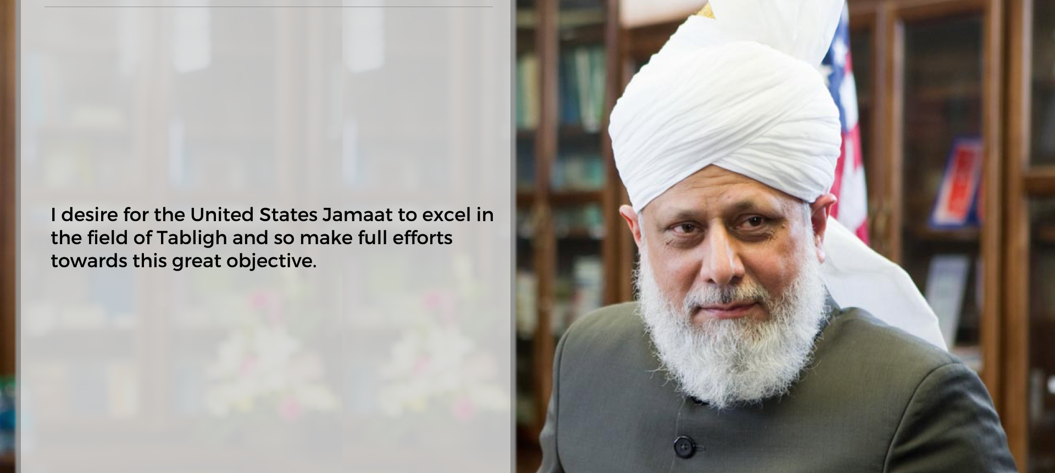
H u z o o r A q d a s

Slide 3
Ethnic Desks
Spanish Desk: Imam Abdullah Muhammad Sayed sb
Bangla Desk: Mirza Ghulam Rabbi sb
Arab Desk: Usama Awan sb
Urdu Desk: Dawood Munir sb
Pacific Island Desk: Feroz Hundal sb
Afghan/Pushto Desk: Nadeem Ahmad sb
Sikh Desk - Wadood Tariq sb
Caribbean Desk – Aslam Ali sb
Native American Desk – Latif Ahmad sb
PAAMA Pan-African Ahmadiyya Muslim Association – Imam Abdullah Dibba sb

Slide 4
Magna Carta of Human Fraternity and Equality
یٰۤاَیُّہَا النَّاسُ اِنَّا خَلَقۡنٰکُمۡ مِّنۡ ذَکَرٍ وَّ اُنۡثٰی وَ جَعَلۡنٰکُمۡ شُعُوۡبًا وَّ قَبَآئِلَ لِتَعَارَفُوۡا ؕ اِنَّ اَکۡرَمَکُمۡ عِنۡدَ اللّٰہِ اَتۡقٰکُمۡ ؕ اِنَّ اللّٰہَ عَلِیۡمٌ خَبِیۡرٌ
“O mankind, We have created you from a male and a female; and We have made you tribes and sub-tribes that you may know one another. Verily, the most honorable amongst you in the sight of Allah, is he who is the most righteous among you. Surely Allah is All-Knowing, All-Aware.” (49:14)
The Farewell address of Holy Prophet (sm) – “An Arab has no superiority over a non Arab, nor a non Arab over an Arab; nor is a white one to be preferred to a dark one, nor a dark one to a white one.”
Our diversity is there to benefit from each other’s national characteristics and good qualities so that it becomes is a tool for unification

Slide 5
Goal & Objective
Reach out to 50% of ethnic population
Ethnic desk to organize their own specific targeted CCTI events
Develop friendship with ethnic communities/ organizations
Invite guests to mosque events, Ijtima and Jalsa

Slide 6
Highlights
Spanish Desk – Pico Rivera/Radio program
Bangla Desk -- NY/DC Book Fair / Jalsa Guests / Monthly Meetings
Arab Desk – Arab Newspaper Ad/Articles
Urdu Desk – Tabligh Stall/Radio Program
Pacific Island Desk – Jalsa Guests
Afghan/Pushto Desk – FB Page
Sikh Desk - FB Page
Caribbean Desk – Baiats/Jalsa Guests
Native American Desk – Native Events

Slide 7
Social Media - Facebook
Spanish Desk - https://www.facebook.com/islam.autentico
and https://www.facebook.com/muslimpico/
Bangla Desk - https://www.facebook.com/ahoban.bangla/
and https://www.facebook.com/AhmadiyyaBangla.org/
Arab Desk : https://www.facebook.com/peacegateUSA/posts/
and https://www.facebook.com/arabicdeskusa/
Urdu Desk: https://www.facebook.com/AhmadiyyaMuslimUrduDeskUSA/
Pastho/Pukhto Desk: https://www.facebook.com/pages/category/Community/Pukhto-Desk-USA-141653609845506/
Sikh Desk: https://www.facebook.com/sikhdesk/
Pacific Island Desk:
Caribbean Desk: https://www.facebook.com/CaribbeanDesk/
Native American Desk:

Slide 8
Dashboard
 | Phone | Email | Core group created? | Regular meetings? | CCTI/Program for Desks? | 10 chapters? | Facebook Page? | Facebook AD? | Total Tabligh Contacts | Total Baiats | Salesforce Report?
Spanish Desk/ Abdullah Sayed | 602-769-3294 | Syed.Abdullah@ahmadiyya.us | Y | Y |  | 3 | Y | Y |  | 7
Bangla Desk / Ghulam Rabbi | 917-363-3673 | ghulam.rabbi@ahmadiyya.us | Y | Y | 3 | 7 | Y | Y | 40 | 3 | Y
Arab Desk / Usama Awan | 614-214-9086 | usama.awan@ahmadiyya.us | Y |  |  | 2 | Y | Y
Urdu Desk / Dawood Munir | 832-526-8614 | dawood.munir@ahmadiyya.us | Y | N | 1 | 2 |  |  |  |  | N
Pastho Desk/Nadeem Ahmad | (630) 276-6842 | nadeemssfhs@gmail.com | Y |  |  | 1 | Y
Sikh Desk /Wadood Tariq | 414-630-8363 | Wadood_tariq@yahoo.com |  |  |  |  | Y |  | 4
Pacific Island Desk / Feroz Hundal | 692 456-5594 | feroz.hundal@ahmadiyya.us | Y |  | 1 | 2
Caribbean Desk / Aslam Ali | (917) 348-3292 | aslamali21@yahoo.com |  |  |  | 1 | Y

Slide 9
Ethnic Desk Plan
Every ethnic desk leader should have two assistants, one general secretary, Local coordinator, women coordinators
Create desks by ethnic concentration
Contact group based on specific ethnicities
Use ethnic newspaper ads reach-out to large number of ethnic population
Use ethnic events to target audience
Use social media to target audience
Provide Health/camp as passive contact generator
Submit summary of Hazoor's sermon every week in a local ethnic news paper
Develop Radio/TV programs for ethnic radio/TV stations
Create an ethnic coordinator with local Tabligh Secretary
Provide feedback to National Team for help needed/information about local ethnic situations or demographic changes
Advertise MTA programs for specific ethnicities
Introduce Humanity First to specific communities
Develop 'Muslim Sunrise' type of publications in different languages
Build relationship with external religious / social organizations
Create additional events outside of Masjid, i.e. book fares, CCTI stall at external events
Invite guests and & dignitaries from ethnic communities to Jalsa

Slide 10
Expectation from Local Chapter
Sacrifice time of local members
Bring guests to ethnic CCTIs
Assist in Daeen Training
Reach out to national desk if there is a large concentration of a specific ethnicity
Reach out to desks to hold local ethnic programs
Participate in local ethnic programs (events), ex. Parade
Assist in social media management
Notifiy ethnic desk when the baiat has occurred with the person’s specific ethnicity
More volunteers to assist in ethnic CCTI

Slide 11
Help from National Team
Internal and external contact management of ethnic desk
Dedicated website to reach out to each ethnic group
National help for local advertising
Social media campaign to target ethnic groups
Coordinate Waqf-e-Ardhi volunteers to each desk
Help with free health clinic
Press conferences and public meetings guidance and support
Jamaat literature for each ethnic group
Record ethnic programs and share with local teams

Slide 12

Any Question

Slide 13
Jazak’Allah!

