Slide 1
Tabligh to Ethnic Communities in the US

Slide 2
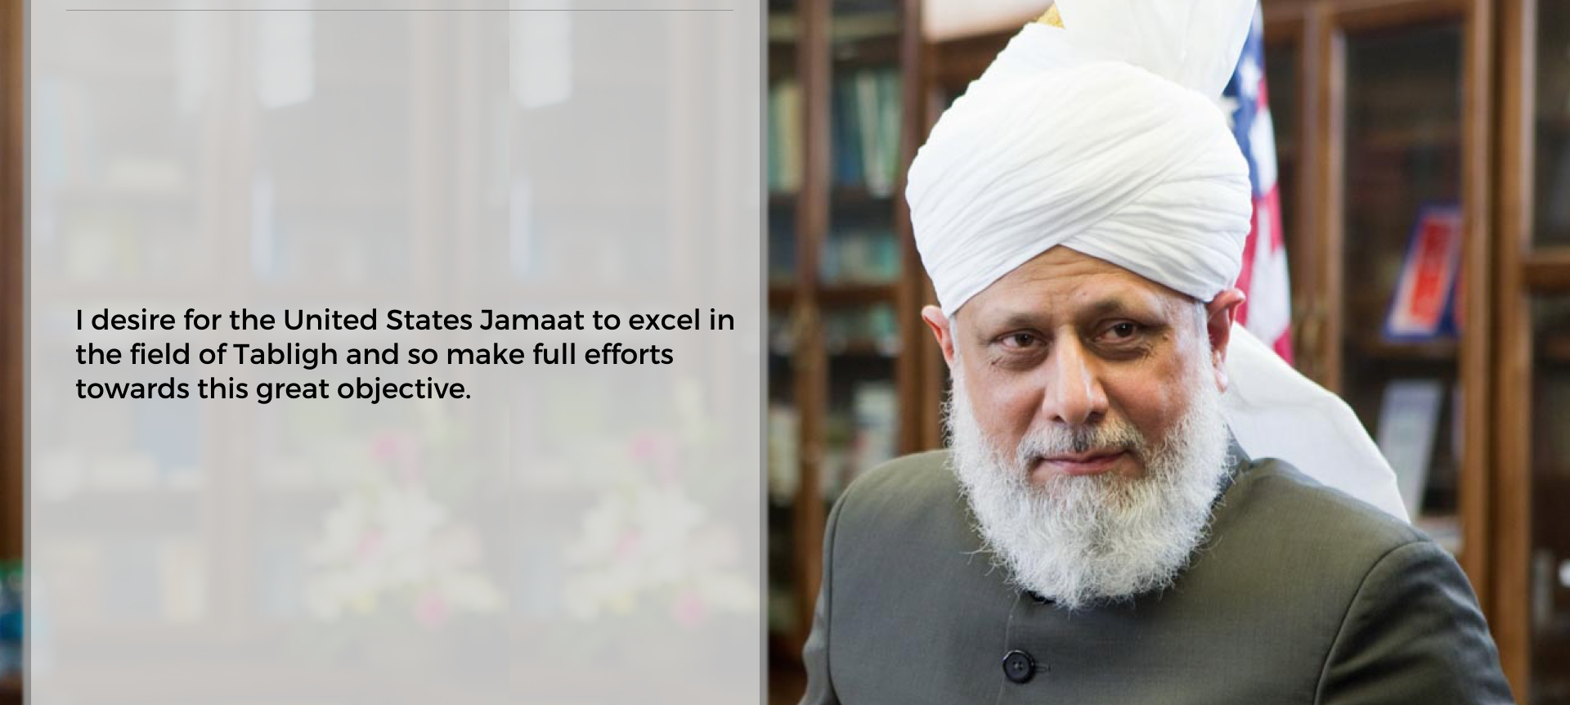
H u z o o r A q d a s

Slide 3
Ethnic Desks
Spanish Desk: Syed Muhammad Abdullah
Bangla Desk: Ghulam Rabi
Arab Desk: Tbd
Urdu Desk: Dawood Munir
Pacific Island Desk: Imam Salman Tariq
Afghan/Pushto Desk: Tbd

Slide 4
Goal & Objective
Reach out to x% of ethnic population
  Reach out 4% of Spanish population
  500 engaged Bengali contacts in the current calendar
  Each desk will set their own target
Understand the demographic from a local perspective
Ethnic desk to organize their own specific targeted CCTI events
Develop friendship with ethnic communities

Slide 5
Plan
Every ethnic desk leader should have two assistants, one general secretary, Local coordinator, women coordinators
Create desks by ethnic concentration
Contact group based on specific ethnicities
Use ethnic newspaper ads reach-out to large number of ethnic population
Use ethnic events to target audience
Use social media to target audience
Provide Health/camp as passive contact generator
Submit summary of Hazoor's sermon every week in a local ethnic news paper
Develop Radio/TV programs for ethnic radio/TV stations
Create an ethnic coordinator with local Tabligh Secretary
Provide feedback to National Team for help needed/information about local ethnic situations or demographic changes
Advertise MTA programs for specific ethnicities
Introduce Humanity First to specific communities
Develop 'Muslim Sunrise' type of publications in different languages
Build relationship with external religious / social organizations
Create additional events outside of Masjid, i.e. book fares, CCTI stall at external events
Invite guests and & dignitaries from ethnic communities to Jalsa

Slide 6
Expectation from Local Chapter
Sacrifice time of local members
Bring guests to ethnic CCTIs
Assist in Daeen
Reach out to national desk if there is a large concentration of a specific ethnicity
Reach out to desks to hold local ethnic programs
Participate in local ethnic programs (events), ex. Parade
Assist in social media management
Notifiy ethnic desk when the baiat has occurred with the person’s specific ethnicity
More volunteers to assist in ethnic CCTI

Slide 7
Help from National Team
Internal and external contact management of ethnic desk
Dedicated website to reach out to each ethnic group
National help for local advertising
Social media campaign to target ethnic groups
Coordinate Waqf-e-Ardhi volunteers to each desk
Help with free health clinic
Press conferences and public meetings guidance and support
Jamaat literature for each ethnic group
Record ethnic programs and share with local teams

Slide 8
Case Study - 1
Scenario Overview
Problem Statement
Best practice & recommendations

Slide 9
Case Study - 2
Scenario Overview
Problem Statement
Best practice & recommendations

Slide 10
Case Study - 3
Scenario Overview
Problem Statement
Best practice & recommendations

Slide 11
Key Takeaway!

Slide 12
Jazak’Allah!

