Slide 1
NAME HERE
Chapter Name
@TrueIslamUSA

Slide 2
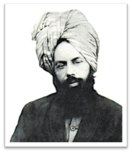
Our organization has denounced extremism for over 100 years
Ahmadiyya Muslim Community Founder
Mirza Ghulam Ahmad of Qadian
Khalifa of Islam
His Holiness Mirza Masroor Ahmad
Denounced Violent Jihad in 1900
“The prevalent tradition among the Muslims of attacking people of other religions, which they call ‘jihad’, is not the jihad of Divine religious law. Rather, it is a grievous sin and a violation of the clear instructions from God and His Prophet, Muhammad.”
- Hazrat Mirza Ghulam Ahmad (ra)
1889-1908
2003-present
● Founder of the Ahmadiyya Muslim Community (1889)
● Ushered in an era of Islamic renaissance
● Mission was to end religious wars, condemn bloodshed and reinstitute morality, justice and peace
● Penned over 80 books and tens of thousands of letters in defense of the true teachings of Islam
● Elected leader of the largest Muslim organization in the world, the Ahmadiyya Muslim Community
● Agricultural economist by education
● Humanitarian, champion of peace, and advocate of absolute justice, kindness and kinship
● Strongly denounces extremism and militant perversions of Islam (e.g. ISIS)

Slide 3
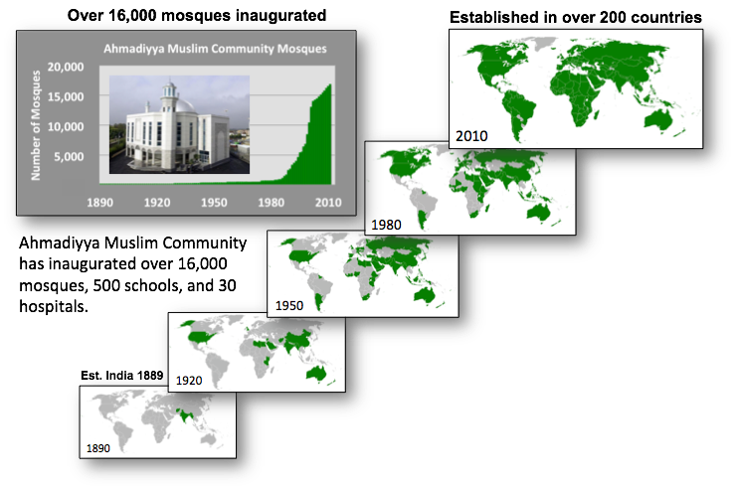
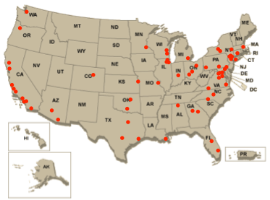
Our organization is the largest American and international Muslim organization under a single leader
Global expansion to 207 countries since 1889; established in America in 1920
Located in over 70 chapters in America
Muslim periodicals since 1902

Slide 4
Our organization has lead award-winning campaigns against extremism to enhance National Security

Slide 5
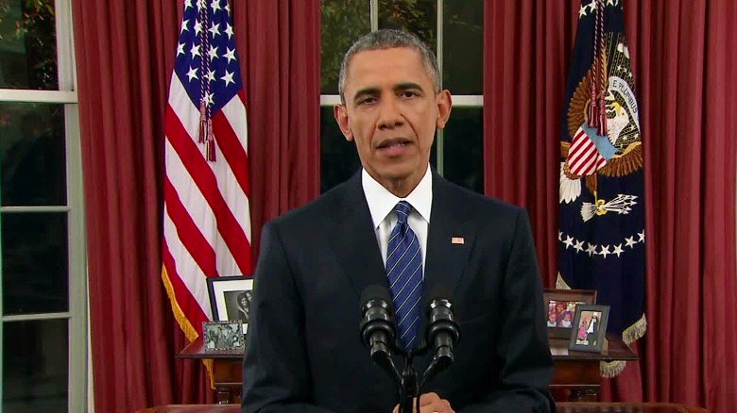
Call to action by President Obama following San Bernardino shooting
“Muslim leaders here and around the globe have to decisively and unequivocally reject the hateful ideology that groups like ISIS and al Qaeda promote”
Dec. 6, 2015 — Oval Office Address following San Bernardino shootings

Slide 6
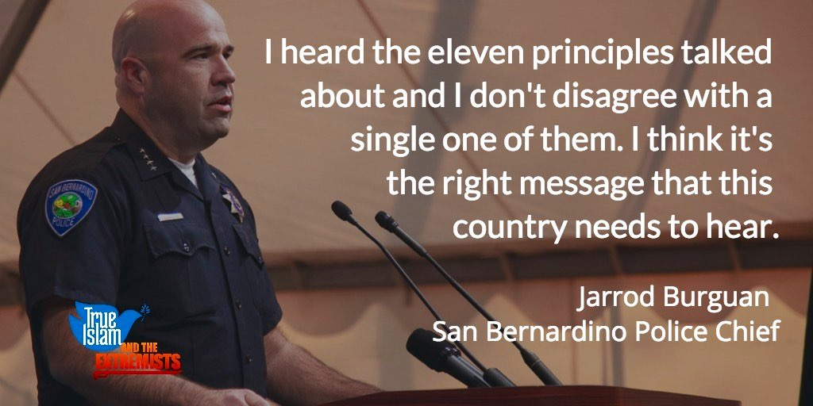
True Islam is a new campaign that calls on all Americans to join in exposing the false ideology of ISIS
11 points
endorse
share
www.trueislam.com
December 26, 2015

Slide 7
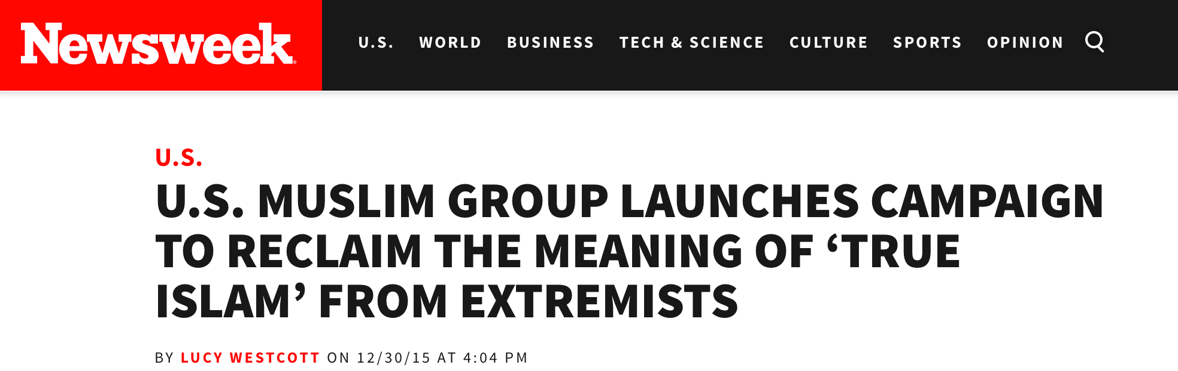
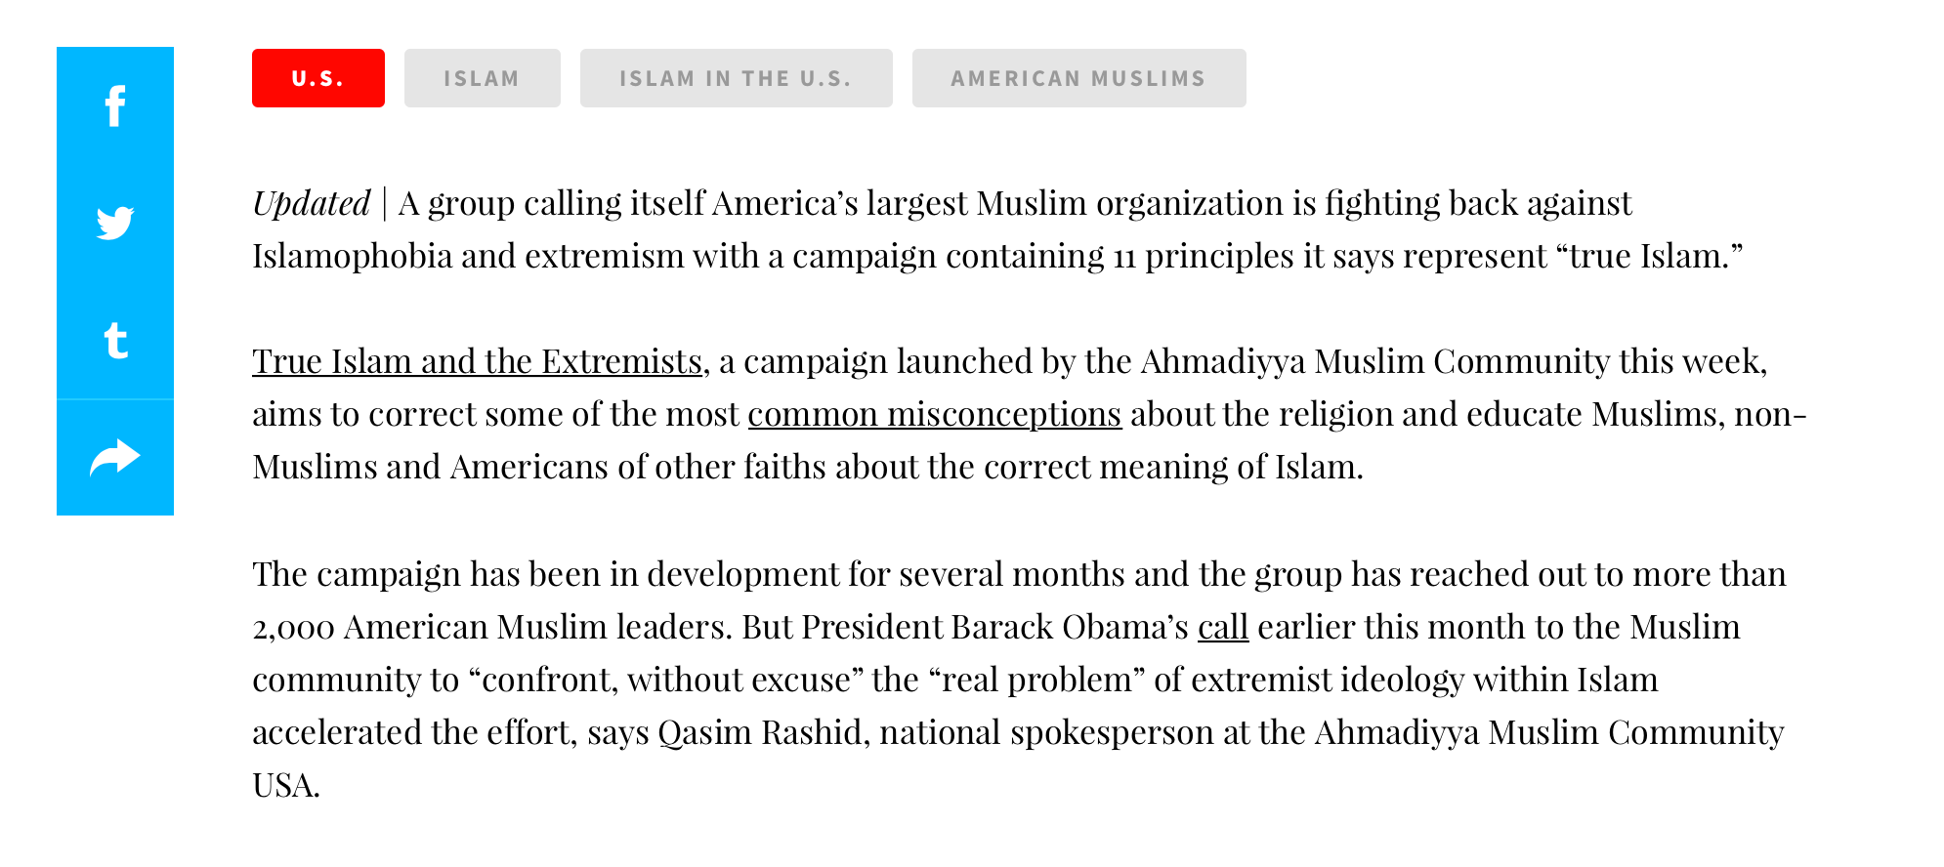
True Islam is gaining momentum with national media

Slide 8
True Islam is based on scientific polling with surprising results that necessitate this education campaign
Muslims in America*
True Islam position
In Islam, blasphemy should not be punished
48% agree
100% agree
Islam requires loyalty to your homeland
52% agree
100% agree
Islam supports separation of Mosque and State
32% agree
100% agree
Islam condemns every form of terrorism
82% agree
100% agree
*Source: YouGov survey sample size 400 American Muslims, margin of error +/- 7.9%

Slide 9
World Peace is threatened when misrepresentations about Islam go unchecked
ISIS is threatening world peace
ISIS recruits by distorting Islam
True Islam counters ISIS ideology

Slide 10
Definitions
Islam, Muslims, and True Islam
Islam is a religion
Muslims are people interpreting the religion of Islam
Extremist interpretations distort Islam giving rise to the need to define True Islam

Slide 11
True Islam is preserved in the Holy Quran and the sayings and practices of Prophet Muhammad
Source: The Holy Quran
Source: Sunnah and Hadith
The Holy Quran
The 11 point True Islam challenge
Sunnah (practices)
Hadith (sayings)

Slide 12
True Islam’s 11-point challenge
The Holy Quran
1. Islam wholly rejects all forms of terrorism
Holy Quran: “Do not go about committing iniquity in the earth and causing disorder.” (29:37)
Holy Quran: “Seek not to create disorder in the earth. Verily, God loves not those who seek to create disorder.” (28:78).
Prophet Muhammad: “Truly God instructs me to be humble and lowly and not proud, and no one should oppress others.”
saws

Slide 13
True Islam’s 11-point challenge
The Holy Quran
2. Islam believes in non-violent Jihad of the self and of the pen
Holy Quran: “Whosoever killed a person … it shall be as if he had killed all mankind; and whoso saved a life, it shall be as if he had saved the life of all mankind.” (5:33)
Holy Quran: “Permission to fight is
given to those against whom war is made, because they have been wronged.” (22:40)
Prophet Muhammad: “Do not revert to disbelief after me by striking the necks of one another (killing each other).”
saws

Slide 14
True Islam’s 11-point challenge
The Holy Quran
2. Islam believes in non-violent Jihad of the self and of the pen
Holy Quran: “And fight in the cause of Allah against those who fight against you, but do not transgress. Surely, Allah loves not the transgressors.” (2:191)
Holy Quran: “And kill them wherever you meet them and drive them out from where they have driven you out; for persecution is worse than killing. And fight them not in, and near, the Sacred Mosque until they fight you therein. But if they fight you, then fight them; such is the requital for the disbelievers.” (2:192)
Holy Quran: “But if they desist, then surely God is Most Forgiving, Merciful.” (2:193)
?

Slide 15
True Islam’s 11-point challenge
The Holy Quran
2. Islam believes in non-violent Jihad of the self and of the pen
Holy Quran: “And fight in the cause of Allah against those who fight against you, but do not transgress. Surely, Allah loves not the transgressors.” (2:191)
Holy Quran: “And kill them wherever you meet them and drive them out from where they have driven you out; for persecution is worse than killing. And fight them not in, and near, the Sacred Mosque until they fight you therein. But if they fight you, then fight them; such is the requital for the disbelievers.” (2:192)
Holy Quran: “But if they desist, then surely God is Most Forgiving, Merciful.” (2:193)

Slide 16
True Islam’s 11-point challenge
The Holy Quran
3. Islam believes in the equality, education, and empowerment of women
Holy Quran: “But whoso does good works, whether male or female, and is a believer,
such shall enter heaven…” (4:125)
Holy Quran: “Surely men who submit themselves to God, and women who submit themselves to Him, and believing men and believing women, and obedient men and obedient women and truthful men and truthful women…God has prepared for all of them forgiveness and a great reward.” (33:36)
Prophet Muhammad: “It is the duty of every
Muslim man and every Muslim woman to acquire knowledge.”
saws

Slide 17
True Islam’s 11-point challenge
The Holy Quran
4. Islam advocates freedom of conscience, religion, and speech
Holy Quran: “There is no compulsion in religion.” (2:257)
Holy Quran: “For you your religion, for me mine.” (109:6)
Holy Quran: “And if God had enforced His will, they would not have set up gods with Him. And We have not made [Muhammad] a keeper over them nor art thou over them a guardian.” (6:108)
Prophet Muhammad: “This is a covenant to those who adopt Christianity, Verily I and my followers defend them… I hold out against anything that displeases them. No compulsion is to be on them. No one is to destroy a house of their religion. No one of the Muslims is to disobey this covenant till the Last Day.”
saws

Slide 18
True Islam’s 11-point challenge
The Holy Quran
5. Islam advocates for the separation of mosque and state
Holy Quran: “Verily, God commands you to make over the trusts to those entitled to them, and that, when you govern between men, you judge with justice.” (4:59)
Holy Quran: “Admonish, therefore, for thou art but an admonisher; thou art not appointed a keeper over them.” (88:22-23)
Prophet Muhammad: “Whoso obeys the ruler obeys me, and whoso disobeys the ruler disobeys me.”
saws

Slide 19
True Islam’s 11-point challenge
The Holy Quran
6. Islam believes in loyalty to your country of residence
Holy Quran: “O ye who believe, obey Allah and obey the Prophet and obey those in authority from among you.” (4:60).
Prophet Muhammad: “You should listen to and obey your ruler, even if you [despise him].”
Prophet Muhammad: “Love of one’s country is part of one’s faith.”
saws
saws

Slide 20
True Islam’s 11-point challenge
The Holy Quran
7. Islam encompasses the Universal Declaration of Human Rights
Holy Quran: “O mankind, We have created you from a male and a female; and we have made you tribes and subtribes that you may know one another. Verily the most honorable among you in the sight of God is he who is the most righteous among you. Surely God is All Knowing, All Aware.” (49:14)
Prophet Muhammad: “All mankind is from Adam and Eve, an Arab has no superiority over a non-Arab nor does a non-Arab have any superiority over an Arab; also a white has no superiority over a black nor does a black have any superiority over a white except by piety and good action.”
saws

Slide 21
True Islam’s 11-point challenge
The Holy Quran
8. Islam believes in all verses of the Quran and forbids lying
Holy Quran: “He it is Who has sent down to thee the Book; in it there are verses
that are decisive in meaning—they are the basis of the Book—and there are others that are
susceptible of different interpretations. But those in whose hearts is perversity pursue such
thereof as are susceptible of different interpretations, seeking discord and seeking wrong interpretation of it.” (3:8)
Prophet Muhammad: “It is obligatory for you to tell the truth.”
saws

Slide 22
True Islam’s 11-point challenge
The Holy Quran
9. Islam recognizes that no religion can monopolize salvation
Holy Quran: “Surely, those who believe and the Jews and the Christians and the Sabians—whichever party from among these truly believes in God and the Last Day and does good deeds shall have their reward with their Lord, and no fear shall come upon them, nor shall they grieve.” (2:63)
Holy Quran: “As to those who believe…verily, God will judge between them on the Day of Resurrection. Surely, God watches over all things.” (22:18)

Slide 23
True Islam’s 11-point challenge
The Holy Quran
10. Islam believes in the need for unified Muslim leadership
Holy Quran: “Hold fast, all together, by the rope of God and be not divided; and remember the favor of God which He bestowed upon you when you were enemies and He united your hearts in love, so that by His grace you became as brothers; and you were on the brink of a pit of fire and He saved you from it.” (3:104)
Prophet Muhammad: “Learn that every Muslim is a brother to every Muslim and that the Muslims constitute one brotherhood.”
saws

Slide 24
True Islam’s 11-point challenge
The Holy Quran
11. wholly rejects the concept of a bloody Messiah
Holy Quran: “Messenger is only responsible for the clear conveying of the Message.” (29:19)
Prophet Muhammad: “I swear by Him Who has my life in His hand that the [Messiah] will indeed descend among you, and he will arbitrate with justice.”
saws

Slide 25
True Islam discredits ISIS ideology
True Islam is peaceful and unites
Take the challenge
The Holy Quran
ISIS does not follow True Islam
The Holy Quran
The Holy Quran

Slide 26
World leaders and the American people need help defining True Islam
President Obama delivers remarks after a briefing on U.S. efforts against ISIS - July 6, 2015
The Ahmadiyya Muslim Community launches True Islam campaign at the UN - Nov 5, 2015
President Obama said, “ISIS distorts Islam. In order for us to defeat terrorist groups like ISIS and al-Qaeda, we must discredit their ideology. Ideologies are not defeated with guns, they are defeated by better ideas”.
True Islam is a better idea; a powerful tool that can be used to expose, discredit, and dismantle ISIS’s false ideology.

Slide 27
Our asks of your office…
Endorse the campaign at www.trueislam.com
Provide a photo and quote that we can use to show your support
Engage in social media by tweeting your support at @TrueIslamUSA #TrueIslam
11 points
endorse
share
Tweet: I've endorsed the @TrueIslamUSA campaign at www.trueislam.com. It unites Americans against extremism & makes our nation safer. Join me!
Tweet: @TrueIslamUSA improves US national security & uses education to counter extremism. This is why I've endorsed it. Join me at trueislam.com!

Slide 28
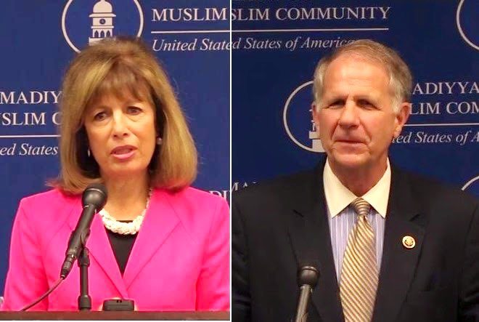
Join the Ahmadiyya Muslim Caucus in support of the True Islam launch event
114th Congress Ahmadiyya Muslim Caucus co-chairs
Rep. Jackie Speier (D-CA) and Rep. Ted Poe (R-TX)

Slide 29
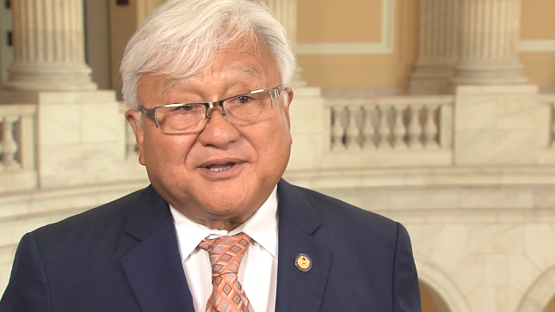
Join the Ahmadiyya Muslim Caucus in support of the True Islam launch event
“By promoting Islam’s message of peace and humanity, the True Islam campaign is, in many ways, at the frontlines in our united fight against extremism”.
- Rep. Mike Honda (D-CA)

Slide 30
Join the Ahmadiyya Muslim Caucus in support of the True Islam launch event
“I’ve heard far too much ugly and un-American rhetoric directed towards Muslim Americans.
That’s why I’m pleased to support the True Islam campaign as they work to better educate Americans about the true meaning of Islam-peace, not extremism”.
- Rep. Zoe Lofgren (D-CA)

Slide 31
Join the Ahmadiyya Muslim Caucus in support of the True Islam launch event
“ISIS is trying to spread a narrative that to be a true Muslim one has to be a terrorist. The True Islam campaign is countering this narrative and not letting terrorist groups like ISIS dictate what Islam is. This campaign is for peace and tolerance. This is a message that we need to elevate. This is a message that must be heard”.
- Rep. Ted Poe (R-TX)

Slide 32
Join us in reviving True Islam
TrueIslam.com
@TrueIslamUSA #TrueIslam

