Slide 1
In the Name of Allah, the Gracious, the Merciful National Tabligh Department, USA
Regional Tabligh Conference 2017

Slide 2
RTC Program
10:00 AM Tilawat & Dua
10:05 AM Opening Speech - National Tabligh Secretary
10:30 AM 2016-2017 report and Plans for 2017-2018 (National Team)
11.30 AM Sign up volunteers (Regional / Local Tabligh Sec.)
12:30 PM Lunch
1:15 PM Salat Zuhr & Asr
1:30 PM How I became an Ahmadi (Woman - recent convert)
1:45 PM How I became an Ahmadi (Man - recent convert)
2:00 PM Men’s/Women’s separate workshop/Q&A (National Team)
3:00 PM Remarks by Local Missionary/President Jamaat
3:15 PM Concluding Remarks & Dua - National Tabligh Secretary
3:30 PM Program End

Slide 3
Last year – 2016-2017 Report

Slide 4
Pre July 2016 Tabligh workflow
Individual
1-1 tabligh in homes
National media interviews, articles
Invite to Mosque and Other programs
Current events
Mosque Open House
Local Jalsas
Social media (Twitter, Social Media)
Book Fairs
Flyer Distributions
Muslims For Life
Loyalty
Peace events
Interfaith Events
Capture contact on paper / spreadsheet
Multiple websites
Phone – 800-Why_islam

Slide 5
H u z o o r A q d a s

Slide 6
Approved Shura Tabligh Proposal 2016

Slide 7
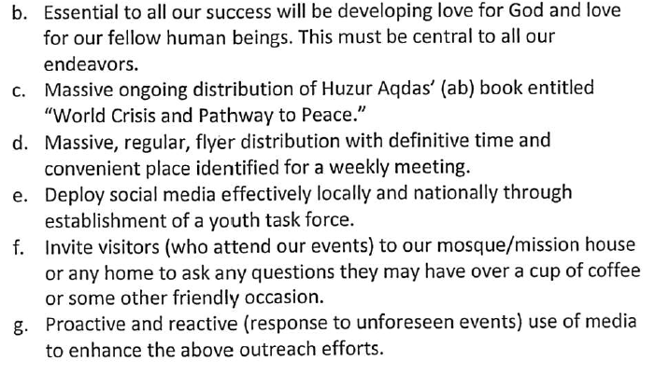
Approved Shura Tabligh Proposal 2016

Slide 8
Post July 2016 Tabligh Pipeline workflow
Current events
Invite to Ahmadi Home
National media interviews, articles
Invite Mosque and Other programs
Social media (Twitter, Social Media)
local CCTI
TrueIslam.com website - endorse
Salesforce contact captured
Live Chat
Phone – 800-Why_islam

Slide 9
Performance: July 2016 – June 2017
Active
Da’een
599

Slide 10
Performance: July 2016 – June 2017
Weekly CCTI
Events Held
2,557

Slide 11
Performance: July 2016 – June 2017
Other Tabligh Events Held
844

Slide 12
Performance: July 2016 – June 2017
New Tabligh Contacts Made
8,653

Slide 13
Performance: July 2016 – June 2017
Total Bai’ats
97

Slide 14
Performance: July 2016 – June 2017
Close to Bai’at
111

Slide 15
Goals/Plans 2017/18 based on Approved Shura Proposals

Slide 16
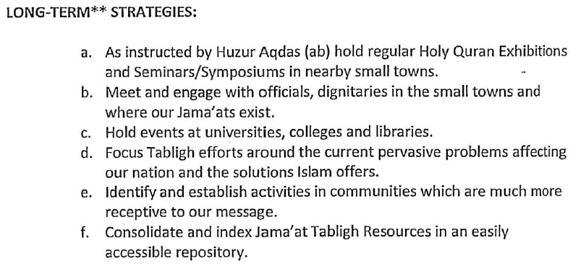
Approved Shura Tabligh Proposal 2016

Slide 17
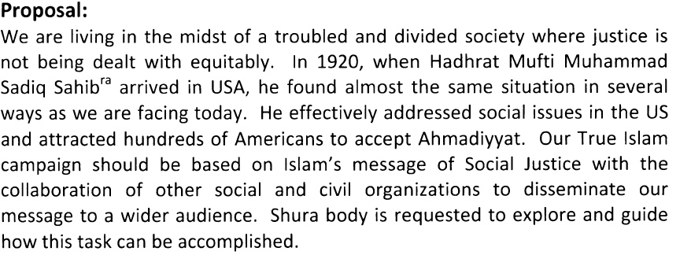
Approved Shura Tabligh Proposal 2017

Slide 18
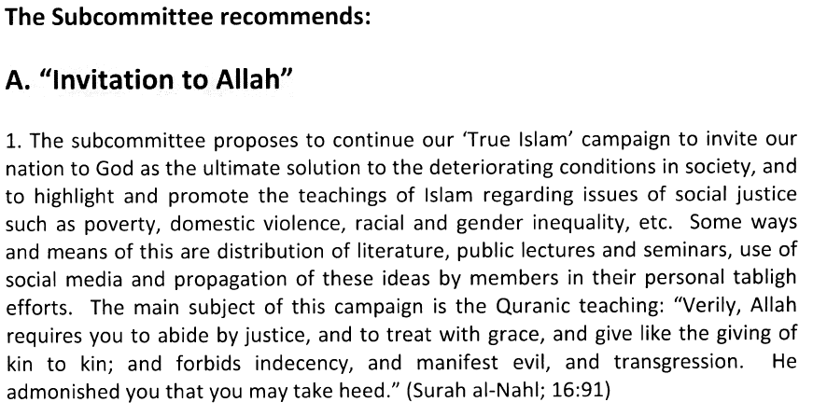
Approved Shura Tabligh Proposal 2017

Slide 19
Approved Shura Tabligh Proposal 2017

Slide 20
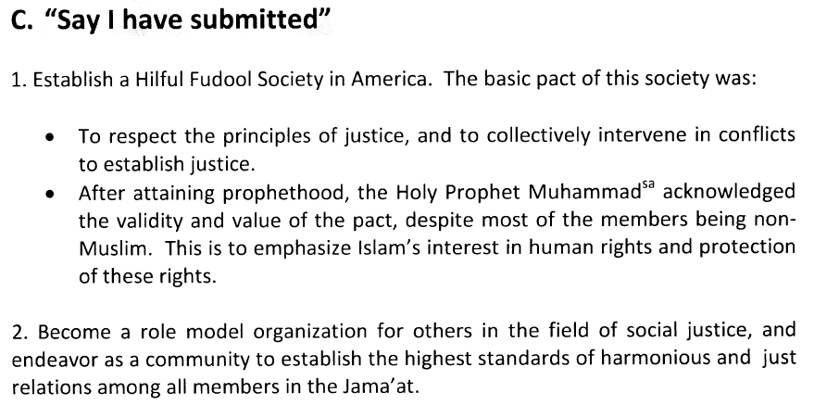
Approved Shura Tabligh Proposal 2017

Slide 21
Goals/Plans 2017-2018 based on Approved Shura Proposals
Coffee Cake and True Islam weekly events in Mosque or outside venue (CCTI)
Women CCTI needs to be started
CCTI Flyers distributions & Facebook advertising – need to choose topics from current social justice issues
Invite to your home ? Show Bai’at form and explain what it means to you
Tabligh In Neighborhoods - Coffee Cake and True Islam in your Homes
Invite neighbors to your home for simple socializing, refreshments and conversation about Islam
Short term goal 2017: 2 Da’een/Households in every chapter to hold consistently this year
Long Term goal 2020: Every household across USA holds CCTI events in home once a month
Tabligh to Ethnic Communities in the US
Spanish Desk, Bangla, Arab Desk, Urdu Desk, Pacific Island Desk, Afghan/Pushto Desk Hold Ethnic
Ethnic CCTI in homes
Small towns and Universities Tabligh & Quran Exhibitions - Hold one program per quarter
Do Good Works - Social Justice issues and True Islam’s solutions
Join service projects to further social justice in our communities
Examples: Homelessness, Education Reform, After school help, Serve Abuse Victims, Race relations, Violence in Communities

Slide 22
Dates - Arabic tradition used to break the fast
Samosa - fried pastry with savory filling of spiced potatoes
Biryani - made with highly seasoned rice and chicken
Raita – yogurt with chopped vegetables and spices
Ruh Afza - flavored rose water traditional drink during Ramadan

Slide 23
2017 - Books Printed fro Tabligh
 | Title | QTY
1 | World Crisis and Pathway to Peace - English | 50,000
2 | Holy Quran English - Soft Cover | 10,000
3 | Holy Quran English - Short Commentary - Hard Cover | 10,000
4 | Elementary Study of Islam (English) | 10,000
5 | Jardin (Islam Gardens of Wisdom in Spanish) | 10,000
6 | Jesus in India – English | 5,000
7 | Jesus en la India – Spanish | 5,000
8 | The Philosophy of the Teachings of Islam - English | 10,000
9 | The Philosophy of the Teachings of Islam – Spanish | 5,000

