Slide 1
In the Name of Allah, the Gracious, the Merciful National Tabligh Department, USA
Regional Tabligh Conference 2017

Slide 2
Regional Tabligh Program 11/18/2017
10:25 AM Tilawat /Translation – Wasim Ahmad Janjua
10:30 AM Dua
10:30 AM Welcome – Muzaffar Siddiqui, Sadr LA Riverside Jama’at
10:35 AM Remarks Dr. Waseem Sayed sahib, National Secretary Tabligh USA
10:50 AM Effective Preaching and Ethnic Tabligh (Mirza Ghulam Rabbi)
11:05 AM Friday Sermon Sept 8th PPT presentation (Moyenuddin Sirajee)
11:20 AM Workshop 1 – What would you like to accomplish today? (Usman Choudhary& Moyenuddin Sirajee)
11:35 AM Workshop 2 – 2017 Tabligh Projects (Usman Choudhary)
11:50 AM Workshop 3 – Group exercise - 30 minutes (All Team)
Split into 6 groups – Team #1-#3 Men / Team #1-#3 Women
What will be your challenges for implementing your project,
Personal Tabligh plan starting Nov 20th
12:20 PM 30 minutes – each team presents and Q&A - 5 minutes each
1:00 PM Salat Zuhr and Asar
1:15 PM Lunch
2:30 PM Spanish Tabligh (Imam Tariq Malik)
2:35 PM 2016 year review & Long term Shura Proposals – Usman Choudhary
2:45 PM Tabligh tools and how to utilize – Ibrahim Naeem
2:55 PM Survey - “Did we accomplish your goals set for today” – scale 1 (Poor) to 5 (Great)
3:05 PM Remarks – Missionary Irshad Malhi sahib
3:20 PM Wrap up – Dr. Waseem Sayed sahib, National Secretary Tabligh USA
3:30 PM Dua

Slide 3
H u z o o r A q d a s Message to USA

Slide 4
H u z o o r A q d a s (Message for USA July 2016)

Slide 5
Approved Shura Tabligh Proposal 2016

Slide 6
September 8th, 2017 Invite to Allah with wisdom and goodly exhortation
September 8th 2017

Slide 7
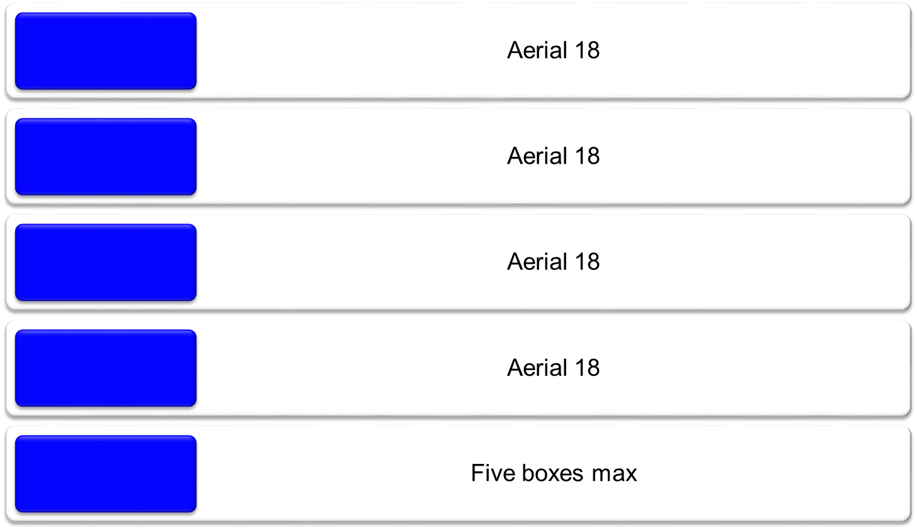
Summary slide Invite to Allah with wisdom and goodly exhortation
“Call unto the way of thy Lord with wisdom and goodly exhortation, and argue with them in a way that is best..”(Ch.16:V.126)
A recommendation was included in the Majaalis-e-Shura of numerous Jamaats around the world.
To expand and improve the scope of Tabligh.
We need to make efforts towards Tabligh in the manner taught to us by Allah the Almighty.
‘The stronger the force of falsehood is which opposes the truth, the power and strength of the truth becomes equally greater.’
September 8th 2017
Notes:
7
*

Slide 8
Invite to Allah with wisdom and goodly exhortation
“Call unto the way of thy Lord with wisdom and goodly exhortation, and argue with them in a way that is best. Surely, thy Lord knows best who has strayed from His way; and He knows those who are rightly guided.” (Ch.16:V.126)
A recommendation was included in the Majalis-e-Shura of numerous Jamaats around the world.
The recommendation was how to expand and improve the scope of Tabligh to spread the true message of Islam to the widest cross section of people possible within each country.
I would like to draw the attention of every office holder that they should extend complete cooperation to the Tabligh Secretaries for the implementation of this proposal within their Jamaat.
It is the duty of the National Secretary Tabligh to send the established programme of action to the Tabligh secretaries of the local Jamaats. Further, they should ensure that the plan of action is conveyed to every member of the Jamaat
September 8th 2017

Slide 9
Invite to Allah with wisdom and goodly exhortation
Most of all understand the guidance given by Allah the Almighty in this verse and every Tabligh Secretary, every office holder and every Daeyaan Khasoosi (specialist preacher) should act accordingly.
You should be aware of where in our literature and websites the intellectual responses to their questions can be obtained from.
Tabligh [outreach] department that they should - considering the current trends - compile such allegations and their rebuttals and make them available to the Jama’ats so that the maximum number of people may have intellectual and strong arguments at their disposal.
We need to make efforts towards Tabligh in the manner taught to us by Allah the Almighty.
Firstly, Allah the Almighty says to carry out Tabligh using wisdom (hiqmah). Hiqmah is knowledge; also denotes ‘a resolute and firm word’ and ‘a conclusive argument, not requiring yet further proofs to establish its validity.’ It also denotes ‘fairness’; also denotes ‘forbearance and clemency’; also denotes ‘prophethood’; it is to refrain from ignorance
September 8th 2017

Slide 10
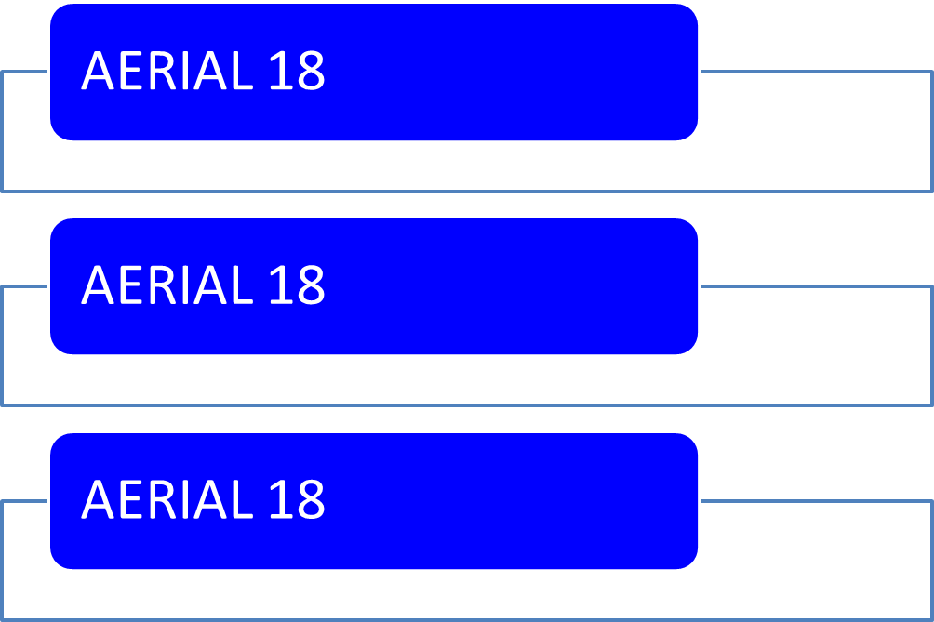
Title
Invite to Allah with wisdom and goodly exhortation
It should not be that once or twice in the year one celebrates the ‘Ashra-e-Tarbiyyat’ or ‘Ashra-e-Tabligh’ [programme of ten days where special focus is given on Tabligh/Tarbiyyat],
distributed literature on the streets and think one has done justice to conveying the message.
Allah has said that your duty is to convey the message and deliver the message of truth to every person of the world.
You must show others the beauty of Islam and its beautiful teachings.
Only God Almighty knows who will be granted guidance and who will not. It is only God Almighty Who knows whether he will be granted the opportunity to accept or not,
We have fulfilled our duty by introducing him to the true teachings of Islam.
September 8th 2017

Slide 11
Invite to Allah with wisdom and goodly exhortation
One should always remember that wisdom does not mean to show cowardice and nor to testify to something incorrect in order to draw someone closer to yourself.
We will fulfil the task given to us but at the same time it is the promise of God that He and His Messenger will prevail, God willing. That is why we have hope that one day the majority will come into our fold.
One should not be worried about the opposition because it is opposition that opens new avenues for Tabligh [outreach].
September 8th 2017

Slide 12
Invite to Allah with wisdom and goodly exhortation
The Promised Messiah (as) states: ‘The stronger the force of falsehood is which opposes the truth, the power and strength of the truth becomes equally greater.’
The Promised Messiah (as) further states: ‘It is also commonly said among the landowners/farmers that the more intense the summer heat, the stronger the monsoon.’
The Promised Messiah (as) further states: ‘This is a natural phenomenon; the stronger the opposition of the truth, the more it shines and reflects its splendour. We have experienced this for ourselves in that wherever we were strongly and vociferously opposed, a Jama’at was established there. And, wherever people heard us and remained silent, there was less progress.’
One should practise what he preaches and it is only then that one can utter words of wisdom and also have an impact on others when there is harmony in one’s speech and practise.
September 8th 2017

Slide 13
Invite to Allah with wisdom and goodly exhortation
The Promised Messiah (as) states:
‘If such people possessed the knowledge and practised what they preach then what need was there for the Holy Quran to state: - why do you say what you do not do?
The Promised Messiah (as) further states: ‘A Momin [believer] should not lead a double life and should always be distanced from cowardice and hypocrisy. Always keep your speech and practice wholesome and show harmony between them both just as the companions did. You too should tread upon their footsteps and demonstrate your sincerity and devotion.’
May Allah the Almighty enable us to adhere according to this.
September 8th 2017

Slide 14
Workshop 1 - What would you like to accomplish today

Slide 15
What would you like to accomplish today?
Let us build this list together …
1.
2.
3.

Slide 16
Tabligh Projects for 2017 for your local Jamaat and each member

Slide 17
Programs 2017
#1
#2
#3

Slide 18
Program #1 – Coffee Cake and True Islam
Coffee Cake and True Islam weekly events in Mosque or outside venue (CCTI)
Women CCTI needs to be started
CCTI Flyers distributions & Facebook advertising – need to choose topics from current social justice issues
Invite to your home ? Show Bai’at form and explain what it means to you

Slide 19
Program #2 - Tabligh In Neighborhoods
Invite neighbors to your home for simple socializing, refreshments and conversation about Islam
Imagine Every household across USA holds CCTI events in home once a month - Long Term goal 2020
This year …2 Da’een/Households in every chapter to hold consistently this year

Slide 20
Program #3 - Tabligh to Ethnic Communities
Tabligh to Ethnic Communities
Spanish Desk, Bangla, Arab Desk, Urdu Desk, Pacific Island Desk, Afghan/Pushto Desk Hold Ethnic
Ethnic CCTI in homes

Slide 21
Group Exercise
#1
#2
#3

Slide 22
Last year – 2016-2017 Report

Slide 23
Two guiding principles
(1) Always remember that the Holy Quran and the Excellent Exemplar, the Holy Prophet Muhammad^{sa} are our guides..and the Imam of the Age, the Promised Messiah^{as}, came to rejuvenate the very essence of what these taught us. So in our presentations let us focus on these sources throughout.
(2) And remember that PRAYER is, in fact, the beam on which all our success rests - so after everything and before everything and in the middle of everything we must emphasize and engage in prayer.

Slide 24
Pre July 2016 Tabligh programs
Individual
1-1 tabligh in homes
National media interviews, articles
Invite to Mosque and Other programs
Mosque Open House
Local Jalsas
Social media (Twitter, Social Media)
Book Fairs
Flyer Distributions
Muslims For Life
Loyalty
Peace events
Interfaith Events
Multiple websites
Capture contact on paper / spreadsheet
Phone – 800-Why_islam

Slide 25
Current Tabligh Pipeline Workflow
Invite to Ahmadi Home
National media interviews, articles
Invite Mosque and Other programs
Social media (Twitter, Social Media)
local CCTI
TrueIslam.com website - endorse
Tabligh Force
Contact captured
Website Chat

Slide 26
Performance: July 2016 – June 2017
Active
Da’een
599

Slide 27
Performance: July 2016 – June 2017
Weekly CCTI
Events Held
2,557

Slide 28
Performance: July 2016 – June 2017
New Contacts (engaged) - 8,653
Close to Bai’at – 111
Bai’ats – 97

Slide 29
Approved Shura Proposals

Slide 30
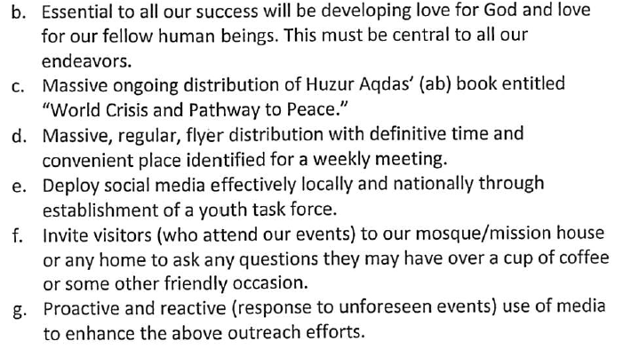
Why are we doing these 3 program?
Approved Shura Tabligh Proposal 2016
#1 - CCTI
#2 - Home

Slide 31
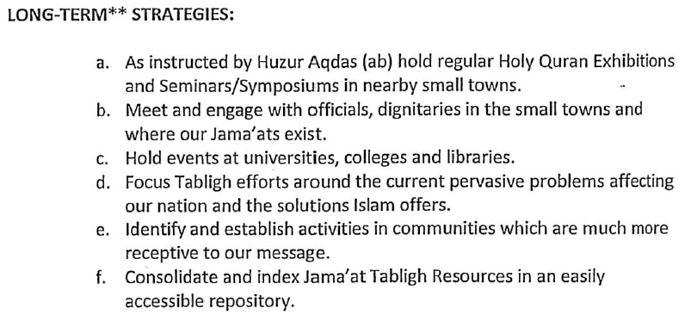
Approved Shura Tabligh Proposal 2016

Slide 32
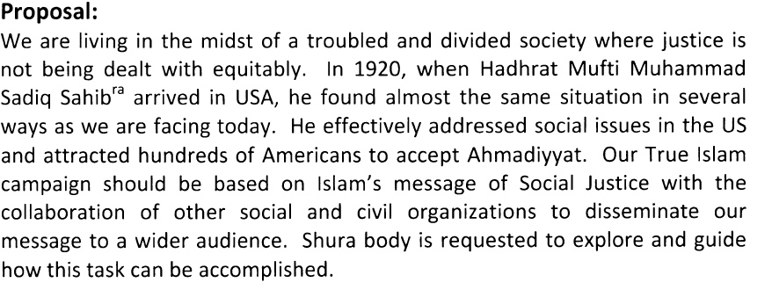
Approved Shura Tabligh Proposal 2017

Slide 33
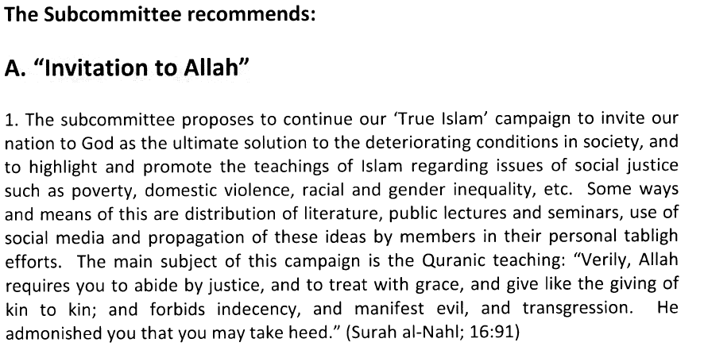
Approved Shura Tabligh Proposal 2017

Slide 34
Approved Shura Tabligh Proposal 2017

Slide 35
Goals - Long Term
Small towns and Universities Tabligh & Quran Exhibitions - Hold one program per quarter
Do Good Works - Social Justice issues and True Islam’s solutions
Join service projects to further social justice in our communities
Examples: Homelessness, Education Reform, After school help, Serve Abuse Victims, Race relations, Violence in Communities

Slide 36
2017 - Books Printed fro Tabligh
 | Title | QTY
1 | World Crisis and Pathway to Peace - English | 50,000
2 | Holy Quran English - Soft Cover | 10,000
3 | Holy Quran English - Short Commentary - Hard Cover | 10,000
4 | Elementary Study of Islam (English) | 10,000
5 | Jardin (Islam Gardens of Wisdom in Spanish) | 10,000
6 | Jesus in India – English | 5,000
7 | Jesus en la India – Spanish | 5,000
8 | The Philosophy of the Teachings of Islam - English | 10,000
9 | The Philosophy of the Teachings of Islam – Spanish | 5,000

Slide 37
Tabligh Tools

Slide 38
Tools for Tabligh

Slide 39
You are not Alone
Send email to
tabligh.helpdesk@ahmadiyya.us
Responses are provided within 24 hours inshallah

Slide 40
Getting the event started
Create your event at
www.trueislam.com/register-an-event

Slide 41
Tabligh Guide
Ask your local tabligh Secretary for a Copy
https://drive.google.com/open?id=0By_BS7dJs5tPR2wzbzJhVEZQWWc
Material for Daeen Training class
Team Building help

Slide 42
Getting Printed supplies
Muslimsforpeace.org/store
Business Cards
True Islam Brocure/Fliers
Holy Quran exhibition displays
Banners
Spanish Items
Also via tabligh.helpdesk@ahmadiyya.us

Slide 43
Documents
GOOGLE Drive
Your local Tabligh Secretary has access to all CCTI and tabligh documents like presentations, fliers, banners, etc

Slide 44
Official email and Security
Google Email platform tabligh.zzz@ahmadiyya.us
Same user ID/password for Salesforce system

Slide 45
SalesForce
https://amc-usa.force.com ( for tabligh secretary)
Mobile Friendly

Slide 46
1800 WHY ISLAM Extension
Already in service for your local tabligh Secretary.
You can use on your business cards
Can be forwarded to a group of mobile numbers, not just your tabligh secretary

Slide 47
Reporting
Via salesforce only

Slide 48
You are not alone.
tabligh.helpdesk@ahmadiyya.us

