Slide 1


Nationwide Blood Drive Campaign
In the Name of Allah, Most Gracious, Ever Merciful
Final Report –2011

Slide 2
Campaign Goals
Emphasize Sanctity of Life practically
Help save up to 10 times lives lost on 9/11.
Goal of 10,000 bags
200 blood donation sites

Slide 3
Campaign Activities
17 Bus stop Shelter Ads in NYC
Seven 14 by 48 foot billboards on prominent spaces in NY, Chicago, Dallas, Houston, Indiana, Los Angeles, San Francisco
25 King Size Bus Banners in DC and Chicago
82 Metro car ads in DC
800,000 flyers printed and hand delivered all across the US
Aerial Ad in Chicago air show
10,000 t-shirts
16,000 individualized letters to all top federal and state leaders and mayors of town all across the US

Slide 4


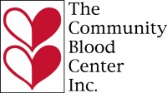

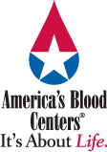





Our National Partners

Slide 5
Our Local Partners
Wildwood Presbyterian Church - Located in Grayslake, IL
Bradford Community Church Unitarian Universalist - Located in Kenosha, WI
Zion Fire and Rescue Department - Located in Zion, IL
Bray Center, Inc. - Located in Racine, WI
Trinity United Methodist Church - Located in Gainesville, FL
Jewish Community Center - Located in Cherry Hill, NJ
Houston Congregation for Reform Judaism - Located in Houston, TX
NorthWoods Presbyterian Church - Located in Houston, TX
Hosanna Lutheran Church - Located in Houston, TX
First Unitarian Church - Located in Dallas, TX
And many more…

Slide 6
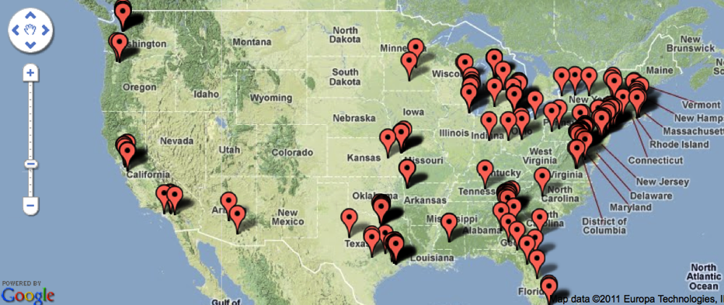
US Map of registered blood drives
269+ sites listed

Slide 7
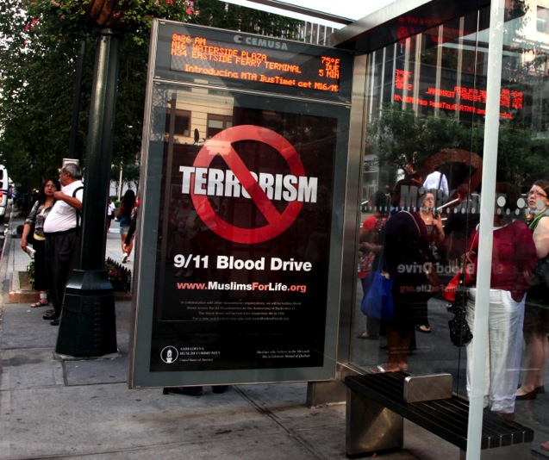
New York City: Bus Stop Signs

Slide 8
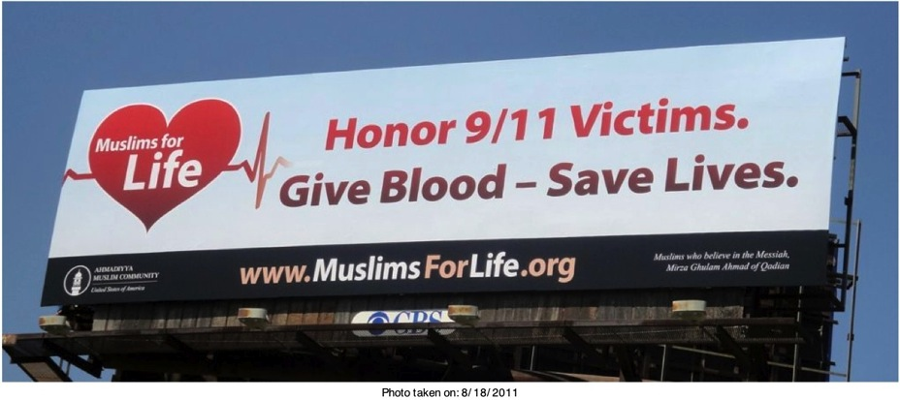
Billboards: Los Angeles, CA

Slide 9
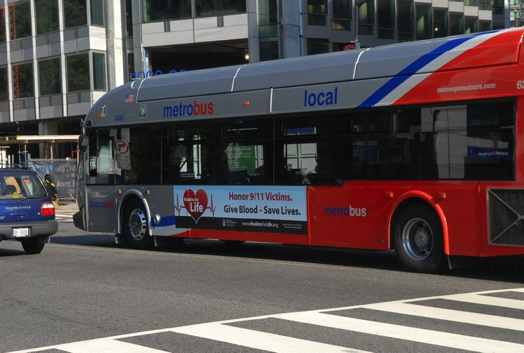
Buses: Washington D.C.

Slide 10
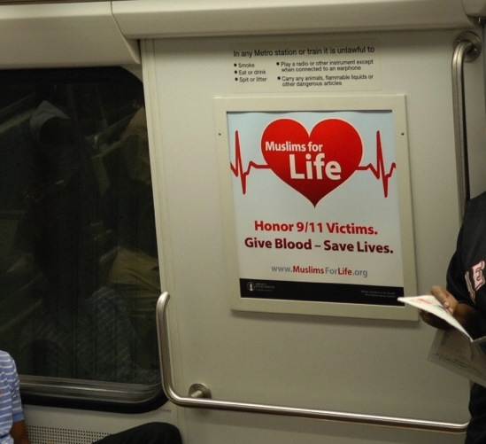
Trains: Washington D.C

Slide 11
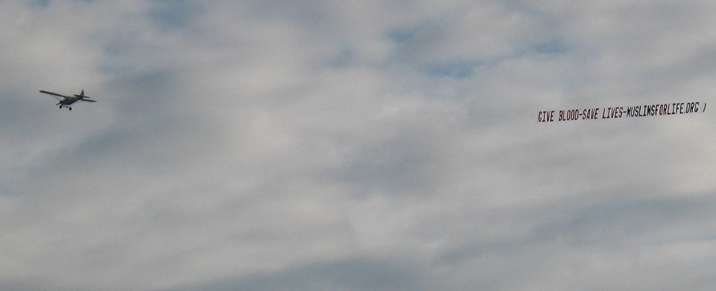
Chicago Air Show

Slide 12
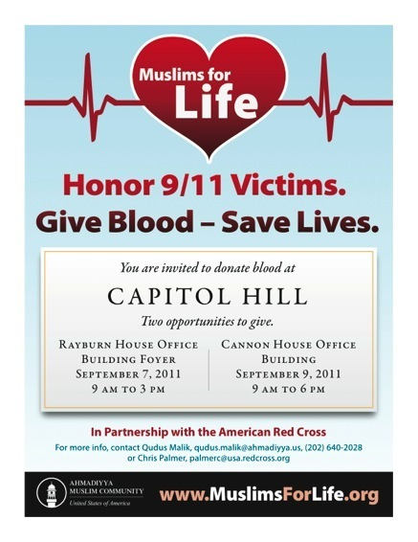
US Congress: Capitol Hill Blood Drive

Slide 13
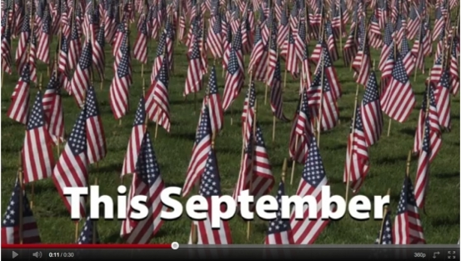
Muslims For Life Campaign: TV Ad
A 30 sec "Muslims for Life" TV commercial made for playing on various TV stations. Our goal is to reach out to the local communities and invite them to participate in the nationwide Muslims for Life Blood Drives but..
Campaign videos and pictures are regularly being added to: http://muslimsforlife.org/gallery

Slide 14
Campaign Results
269 locations registered in 166 US cities
11,000+ pints collected

Slide 15
Media Coverage
Over 260 Unique news articles published across US
Radio: 12 Nationwide; KFPT, WTOP, 1010 NY
TV – 31 Major stations, new regions in heartland
Print – 75 including Biggest papers in regions: LA Times, Atlanta Journal Constitution, Charlotte Observer, …
Internet – 72, AOL Patch – new reach into small towns
International: BBC Brazil, Japanese, Italian, VOA Bangladesh, VOA Afghanistan

Slide 16
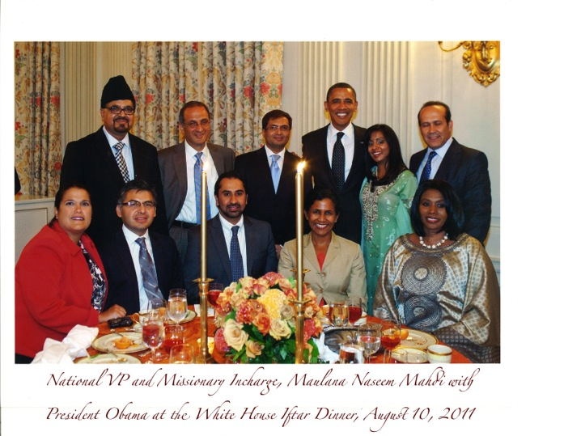
MuslimsForLife introduced at White House

Slide 17
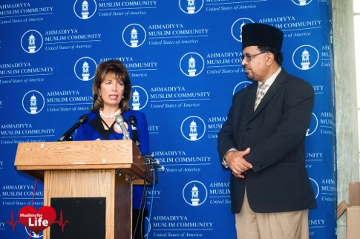
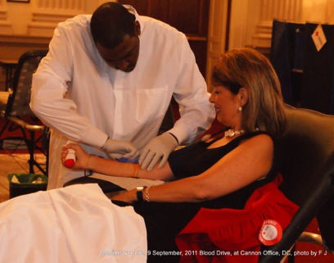
Capitol Hill Blood Drives
Congresswoman Jackie Speier (Democrat-California)

Slide 18
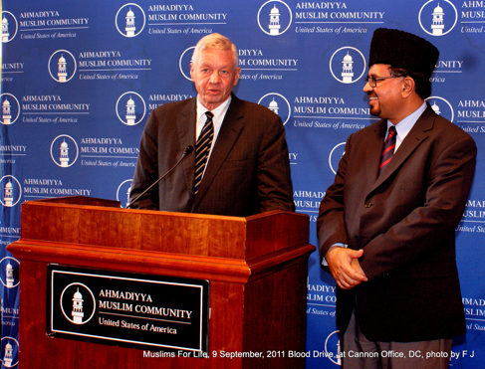
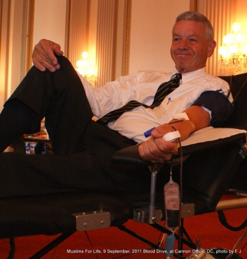
Capitol Hill Blood Drives
US Congressman Tom Petri (Republican-Wisconsin)

Slide 19
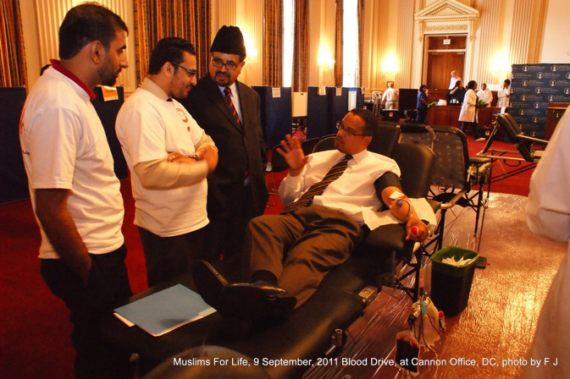
Capitol Hill Blood Drives
US Congressman Keith Ellison (Democrat-Minnesota)

Slide 20
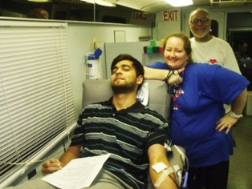
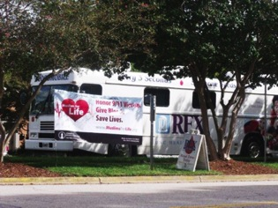
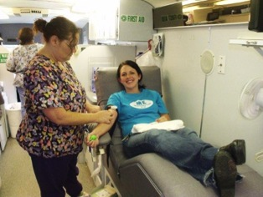
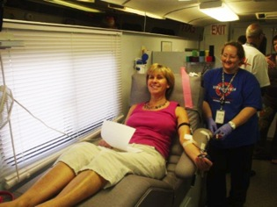
Cary, NC: AMC Center Blood Drive

Slide 21
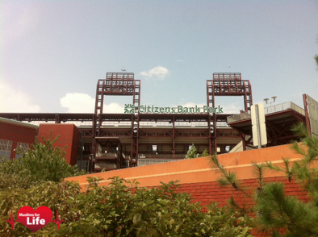
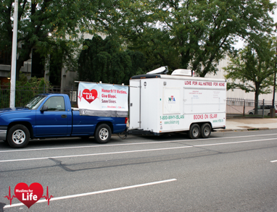
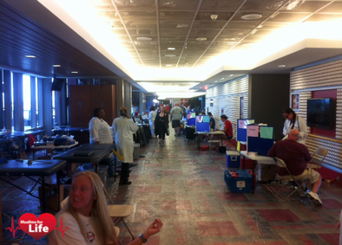
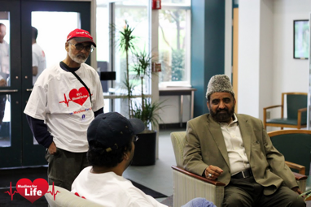
Philadelphia Phillies Game
Citizens Bank Park - Blood Drive

Slide 22
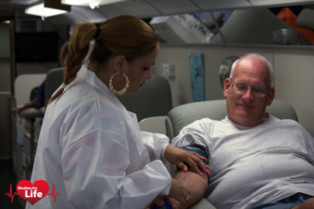
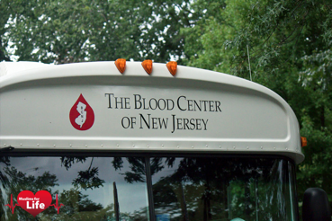
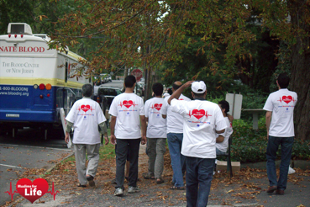
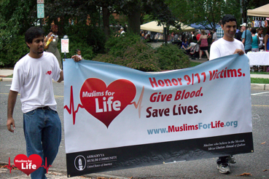
New Jersey Blood Drive

Slide 23
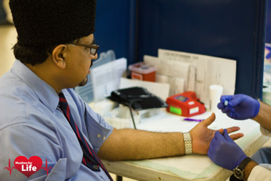
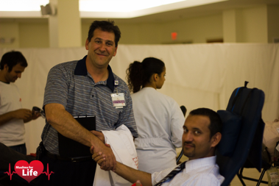
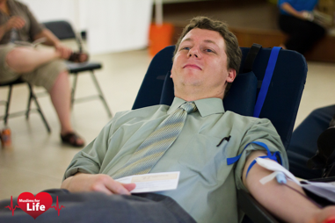
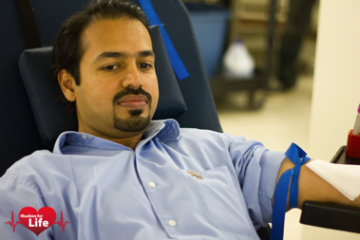
AMC National HQ
Bait-ur-Rahman Mosque, Silver Spring, MD

Slide 24
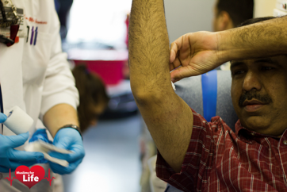
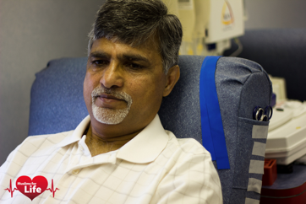
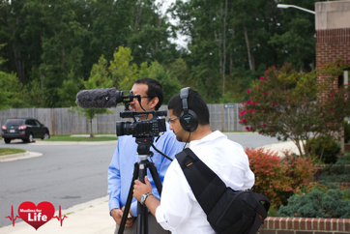
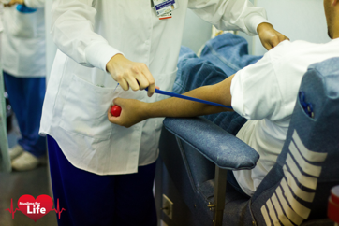
Central Virginia, Blood Drive

Slide 25
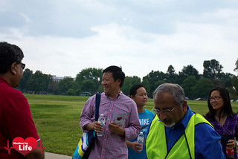
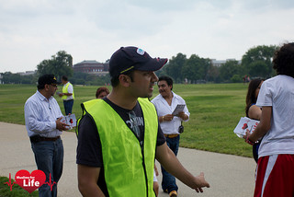
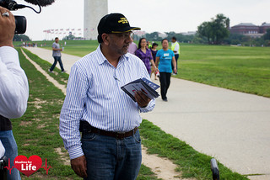
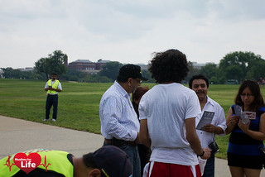
Washington D.C. Monument
Flyer Distribution

Slide 26
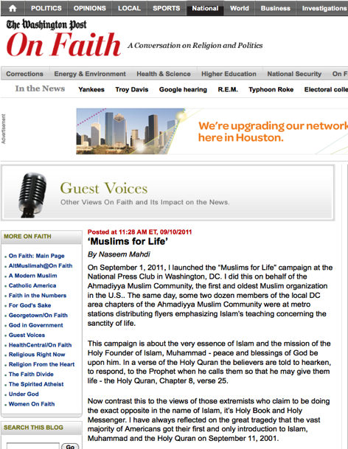
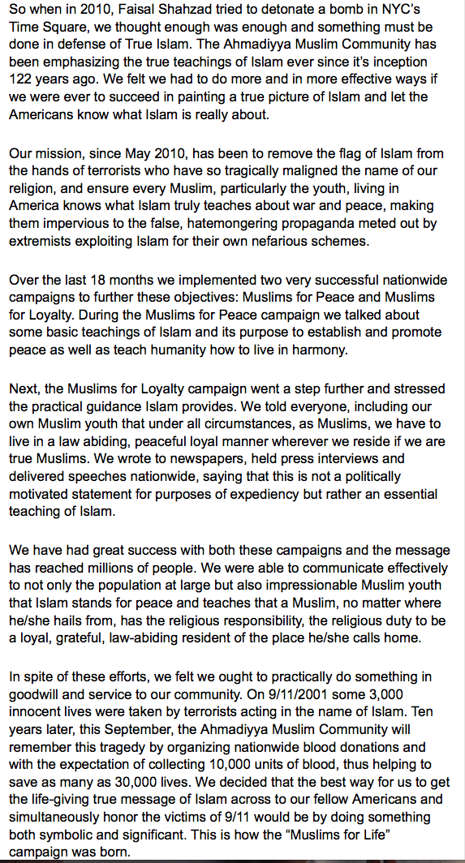
News Coverage: Washington Post

Slide 27
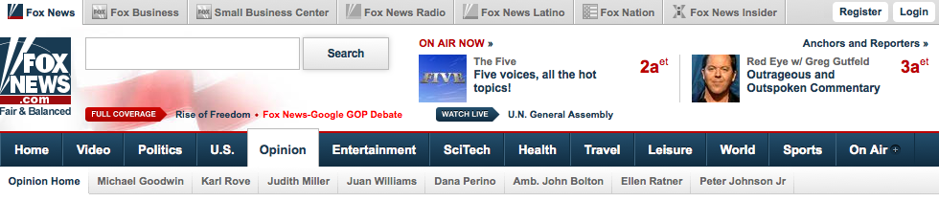
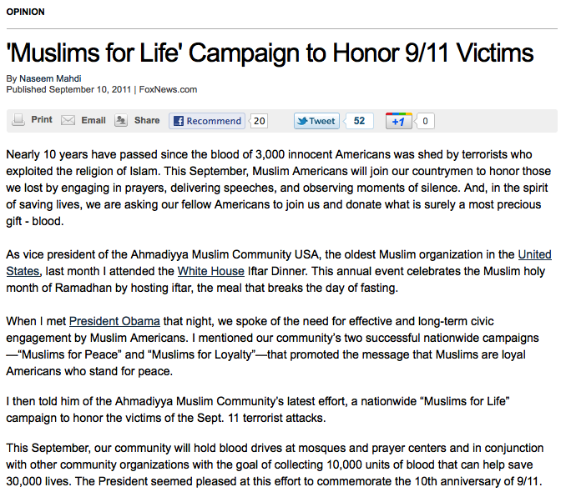
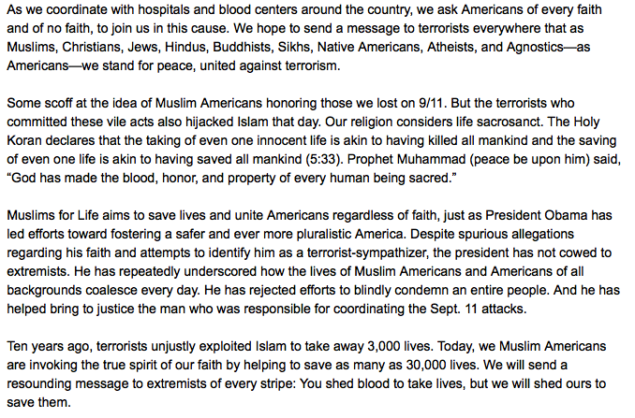
News Coverage: Fox News Opinion

Slide 28
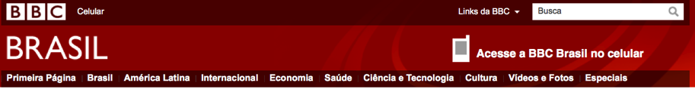
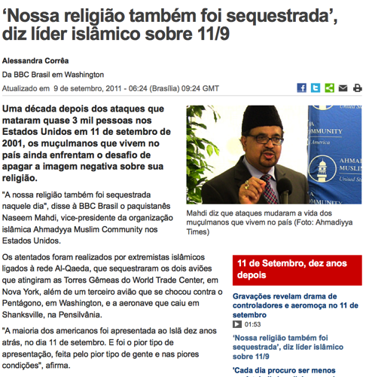
News Coverage

Slide 29
Positive Impact on US Population
Michael wrote to us: “I just saw your story regarding your blood drive on CNN.com. As a Native American descendant, I was really angry about the terroristic acts perpetrated on 9/11. I have harbored a certain percentage of that anger for 10 years. All of the ceremonies that have marked that evil act of mass murder brought all that anger back. I have held a great hatred for Muslims in general for many years since then. I can say in all honesty that that hatred has lessen over the years but was still there. When I saw the story regarding the blood drive, I thought “what if this is just a PR stunt? And then for some unexplainable reason, I started to cry. I felt all of that anger, hatred; resentment and racial bigotry leave me.”

Slide 30
Positive Impact on US Population
The clip of the CNN iReport story can be viewed here: http://ireport.cnn.com/docs/DOC-671618
The first passerby they interview is a Jewish man who says once he saw that these were Muslims doing this blood drive and being a Jew he just had to come and donate blood...

Slide 31
Positive Impact on US Population
Then there is the music minister Missy O'Brien from Unity Church of Christ in Mount Laurel who waited for an hour to talk about the wonderful Muslims for Life campaign on the 1210 AM Chris Stigall Show - and she says since she was waiting for an hour she had written down what to say.. here is her own email recounting the story on the next page…

Slide 32
From: <micmis@comcast.net> Date: Fri, Sep 9, 2011 at 10:25 AM Subject: Radio plug for September 10th and 11th Blood Drive To: sulemanmshaikh@gmail.com Hi Muhammad, This morning on the radio- 1210AM- on the Chris Stigall show- the discussion was how do people in the community deal with 9/11. So I called in. In the last three minutes of the show I was able to share about your blood drive. Since I waited about an hour on hold to speak, I wrote down what I wanted to say. Here is the jist of it. Hi Chris, It has been very important to me as well as my church to continue the community bonding that James was just talking about. (James is the filmmaker of the 9/11 film that will be aired on Sunday on CBS from 8-10 who was being interviewed right before they put me on the air.) I am the music minister of Unity Church of Christ in Mount Laurel and I personally, and our church put out flags, have had prayer vigils, concerts through the years and have had a friend of mine, who is a survivor of 9/11, come and speak to us. Each year on Thanksgiving Eve, our church, in conjunction with area houses of worship from the Jewish, Christian and Muslem faiths, have an Interfaith Service where we focus on how we are more alike that different. After 9/11 this service became even more significant. Because of a relationship that has come from this Interfaith Service, our church has been given an oppurtunity to go one step further this year on 9/11 to do something special and support the efforts of the Muslem Community of Willingboro in New Jersey who are taking part in a nationwide campaign Muslemsforlife.org. | Their idea is that 3,000 people lost their lives on 9/11, and since it is the 10th anniversary, that 3,000 x 10 has given them the goal of raising 10,000 units of blood that can save 30,000 people. This goal saves lives and honors the sanctity of life. This weekend, on Saturday the 10th, and Sunday the 11th, at 500 Bridge Street in Willingboro, from 9-3 they will be having their blood drive. It is a wonderful cause that our church is participating in and that their Imam, Muhammad Suleman, has said will send a message to the terrorists that regardless of faith, we are united. Chris, the host, asked where can they get more information about this. I repeated the muslimsforlife.org website and he asked me again where and when. So I gave your address and the times. He said thank you for calling. You are doing more to honor 9/11 than Mayor Bloomberg. I trust and pray that this will bring even more people to your blood drive and more importantly, help people join in uniting our communities even more. Looking forward to seeing you and yours on Sunday, Missy

Slide 33


Slide 34
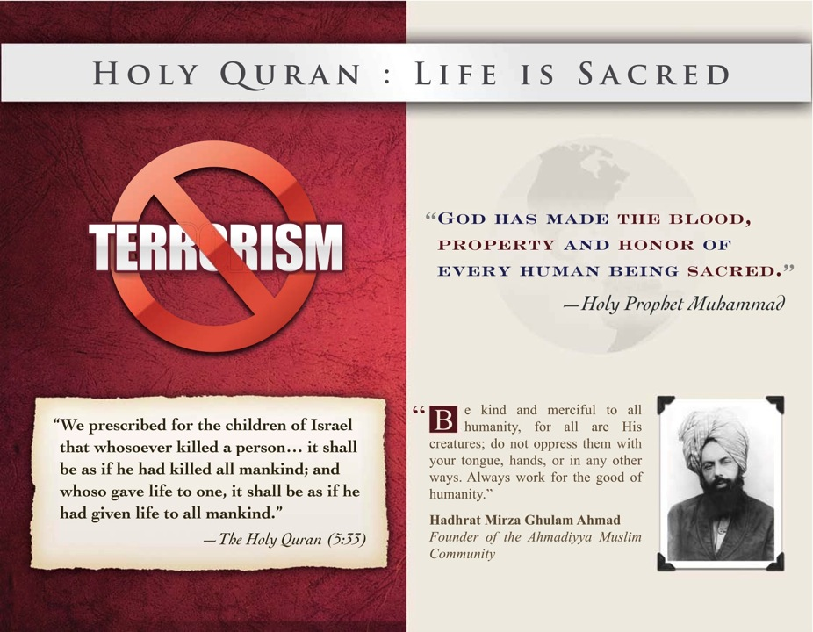

Slide 35
2012 Nationwide Muslims for Life Blood Drive
376 Blood Drives by 207 Registrants; So far 189 Completed Data 8,628 pints
Concept of Outreach Now Widely understood by members. This is what we need to do REACH OUT!
Seattle Jama’at - 27 blood drives and 626 pints
Atlanta: 28 [+ 30 - a month-long effort] one day blood drives all told and some 1,361 pints
Miami Jama’at - Fourteen, 11-day long blood drives plus additional – Equivalent of 154 one day blood drives

Slide 36
2012 Other Major Efforts
Detroit, NINE blood drives, 409 pints;
NY: Queens, Brooklyn, Long Island - ELEVEN blood drives, 624 pints;
Willingboro, EIGHT blood drives, 304 pints;
Dallas & Fort Worth SEVEN blood drives, 174 pints - one pending;
N.J. SIX blood drives, 103 pints;
FIVE blood drives: LA West 159 pints; Houston N&S, 136 pints;
FOUR blood drives: RTP [131 pints]; Zion [89 pints]; Chicago East [74 pints]; and Washington, DC [21 pints];
With THREE blood drives: Tulsa [204 pints]; C. VA [145 pints]; and C. Jersey [136 pints].

Slide 37
Other 2012 Blood Drives
TWO blood drives each: Philadelphia [1,248 pints]; Boston [999 pints]; Baltimore [404 pints]; San Diego [99 pints]; Capitol Hill [92 pints]; Portland [68 pints]; Osh Kosh [59 pints]; Austin [56 pints]; Charlotte [50 pints]; N. VA [44 pints]; Indiana [34 pints]; Kansas [29 pints]; and Columbus [21 pints].
ONE blood drive each: Silver Spring (38); St. Louis (7); Hartford (40); Dayton (20); Laurel (40); New Orleans (38); Syracuse (28); Fitchburg (35); Alabama (18); Buffalo (19); Milwaukee (21); BayPoint (13); Silicon Valley (23); Orlando (14); Sacramento (12); S. VA (34); Phoenix (24); Tucson (17); Binghamton (17); Kentucky (16); Richmond (32); Rochester (23); York (28); Houston Cypress (16); Lehigh (28); Cleveland (14); Merced (8); and Albany (22).
A couple of Jama’ats did half a blood drive each: L. A. East and L. A. West together did one blood drive (32).
No Reports Yet: Potomac, Athens, Oakland, and Las Vegas.

Slide 38
High School Blood Drives
ONE AMAZING thing that happened this year and that all Jama’ats must try and copy next year is that in Atlanta Jama’at a young girl at a girls high school organized a very successful “Muslims for Life” blood drive at her school which was fully supported by all the school. If this is done by every Jama’at’s high school students in all their high schools we could see close to 400 “Muslims for Life” blood drives just in this way insha-Allah!

Slide 39
Growing Collaboration with Major League Baseball Franchises
Amazing success with MLB franchises. Philadelphia Phillies and the Boston Red Sox organizations fully on board...have been for two years. Alhamdolillah!
Boston Jama’at held a “Pre-Launch” dinner for the community at which they invited everyone they wanted to collaborate with in the Muslims for Life Blood Drive work and they told them what we had in mind and what had been accomplished in 2011. They found this very useful in getting everyone in their community energized informed and readied for the forthcoming Muslims for Life work. This may be something worth doing more widely.
This year we added the Baltimore Orioles to the big organizations we are working with.

Slide 40
State Capitols & City Halls
Also we had some success with Muslims for Life blood drives in State Capitols [Wisconsin, Sacramento...] and City Halls [Dallas, Wylie, DeSoto, Plano, Allen, Cedar Hill, and Lancaster; Also Houston]. This needs to be further expanded.

Slide 41
Advertising: Print & Electronic Media
NEW THING WE TRIED THIS YEAR WAS ADVERTISING IN PRINT AND ELECTRONIC MEDIA. We will present a detailed report when we have closed the campaign. [show pictures]

Slide 42
Media Coverage
Newspapers: 67 publications, approximately 3,995,626 people.
Websites: 50, approximately 967,838 people.
Radio Stations: 8 Radio interviews 36,032,000.
TV Channels: 22 TV interviews or news about MFL – estimate of 200,000 audience per station – 4,400,000.
Total: 45 million more or less…very preliminary numbers

Slide 43
Faith Inspiring Comments Received ..
Report from New York: Here is an account from brother Omar Meelu: "The blood drive today was a tremendous success. There were many people willing to donate their blood and it was heartwarming to see such a response on such a sweltering day in the city. On more than a few occasions, we had to halt our recruitment of blood donors due to the overwhelming number of people donating. But even we stopped, people still came and said they wanted to donate blood. By witnessing the scenes in Union Square, it is obvious that God Almighty's blessings are with this Muslims for Life campaign."

Slide 44
American Red Cross
American Red Cross Liaison Rachel Fink showed her support to the Muslims For Life Campaign in Philadelphia through her gratitude by stating how we understood “the importance of supporting a community blood drive [where] hospital patients will depend on each of the blood donations that you helped collect.”

Slide 45
KOMO NEWS RADIO
Date: Thu, 6 Sep 2012 09:15:27 -0700
From: ghersholt@fisherradio.com
To: ichaudhry@amiseattle.org
Mr. Chaudhry --
Thank you for the note about my donation to this week's blood drive. I happen to be a news broadcaster for KOMO NewsRadio and was inspired to donate by a story we did that morning.
All of this has gotten me thinking: I would like to talk with you about the Muslim perspective as we approach 9/11 and get your side of the resulting attitudes toward your people. How is it for you? Are you overcoming the negative stereotypes through good works and community action such as the blood drive?
Perhaps we could speak on the phone if you're willing to talk about this. I would appreciate it.
Gregg Hersholt
Komo Morning News
206.404.3146

Slide 46
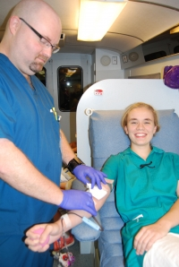
High School Blood Drive
Dear Sadar Sahib, Today at Najia's school the blood drive went very well by the grace of God. A total of 36 girls and teachers came to donate, and 29 units were collected. Below is a link to the school's website about this drive.
Wassalam, Naseer
http://www.gps.edu/subpage.php?title=bruiser-net&q=
RECENT NEWS
Donors Honor 9/11 Anniversary
Wednesday, September 05, 2012
GPS sophomore Najia Humayun successfully coordinated the most recent blood drive on campus, asking students and faculty to donate blood in support of the second annual campaign by Muslims for Life, a national organization with a goal of 11,000 units for blood banks across the country.

Slide 47
Buford Patch
Posted on September 6, 2012 at 1:11 pm
http://buford.patch.com/blog_posts/muslims-for-life-blood-drive-at-mall-of-georgia The Ahmadiyya Muslim Community (GA Chapter) finished a very successful three-day blood drive run at the Mall of Georgia over this past weekend collecting 162 units of blood. The effort was part of its second annual nationwide campaign ‘Muslims for Life’ in honor of victims of 9/11. All 71 chapters of the community in the country have been holding blood drives since August 11th, 2012 to help Red Cross tackle their critical need of blood while giving the message of peace and life.
The campaign took life last year at the tenth anniversary of 9/11 and was a great success when the organizers surpassed their goal of 10,000 units concluding with more than 11,000 units collected nationwide. It seemed as if the public was waiting to hear the message of life and peace from Muslim Americans and with this campaign they got what they were looking for.
Muslims make less than one percent of the American population yet it seems there has been recent increase in anti-Muslim sentiment in the form of hate attacks, a trend that needs to stop.

Slide 48
Milwaukee Jama’at Blood Drive
From: Bronstad, Alice <Alice.Bronstad@BCW.edu>;
To: 'nasirullahahmad@yahoo.com' <nasirullahahmad@yahoo.com>; 'bahmad50@gmail.com' <bahmad50@gmail.com>;
Subject: Excellent blood drive today!
Sent: Sat, Sep 8, 2012 10:53:58 PM
Many thanks to both of you and Sister Sa-eed for sponsoring the blood drive today at your mosque. 27 donors presented and only six were deferred. 21 donated and 14 of those were new donors - either new to BloodCenter or first time donors. All of these donors heard the message! The collective result of the one hour of time donated by these people, 63 lives were saved or extended. Our patients are so grateful.
Please share with your congregation that their generosity memorializes the lives lost on 9/11. I would like to meet with all three of you within the next month to pick a date and lay some plans for the 2013 drive. We can send out quarterly "Save the Date" reminders to solidify response next September. I welcome your comments on today event. Your donors appeared to appreciate having "their own" blood drive and BloodCenter's staff enjoyed serving them. Looking forward to hearing from you, Alice

Slide 49
President Pasadena City College
Support from the college president for Muslims For Life.
Sent from my iPad
Begin forwarded message:
From: "Mark W. Rocha" <MWROCHA@pasadena.edu>
Date: September 11, 2012 9:54:45 AM PDT
Subject: Message from the President on 9/11
Dear Campus Community:
Today marks the 11th anniversary of 9/11 and I have requested that campus flags be flown at half mast in honor of those we lost.
I also want to call attention to a wonderful service event on campus sponsored by Muslims for Life who, along with our Kaiser and Providence health care partners, are conducting a blood drive in the Circadian, 9am-3:30pm. Many of our faculty, staff and students are involved in this effort. There is an urgent national need for donated blood of all types, so we should all be grateful to Muslims for Life for their work today in
giving the gift of life.
We can all be especially proud on this day of PCC's service to the community. Thank you all for leading us toward the light.
In hope and heart,
Mark
Mark Rocha
Superintendent-President
Pasadena City College
Direct Mobile: 818-207-3027

Slide 50
Rabbi Jaron Matlow, Olympia, WA
Name:Rabbi Jaron Matlow, Email ravyaron@gmail.com, Phone Number(360) 951-8899
My dear Ahmadiyya friends, I heard a representative of yours speak on KOMO News Radio Seattle this morning and I was very touched.
He quoted from the Holy Qur'an saying that To Save a Life is to Save the Whole World.
It always amazes me, given the state of Jewish-Muslim relations, how much of the Qur'an is similar to our Holy Torah and Rabbinic Teachings.
In our Second Century Mishnah Sanhedrin 4:3 is the same statement.
I truly wish that your organization could influence all of Islam, so we could find a way to end this cycle of death, and instead to live by our Holy beliefs.
Rabbi Jaron Matlow
Private Rabbinic Services
Olympia WA

Slide 51
Name: Tom Mitchell, Email: greenmit@q.Com
Message: I gave blood today in Portland, OR and met a couple of people connected to your organization. I also received a great chocolate bar and t-shirt. I appreciate your efforts and look forward to a day when it is no longer necessary. On a side note, I am Jewish.
Good luck and Shalom.
Tom

Slide 52
Jim Hale – Vietnam Veteran
Name: jim hale; Email: sunwatt@madisoncounty.net; Phone: (479) 665-2712
Message: Im very sorry for the hatred my fellow Americans show sometimes. It shames me.
Im a totally disabled Vietnam veteran and live in NW Arkansas. I saw the story on local TV and wanted to give any support I can.
Having been ruined by this war over lies, which I believed, my eyes are open to this new situation.
Im a poet and speaker...................
Our troops are on bases in lands far away; I cant help but wonder what grandfather would say
He sailed from England for a better life; And here's where he lived and married his wife
There were children born and that led to me; I've followed the path on my family tree
The British Empire stretched far and wide; But he joined the militia on the American side
Today we're deployed in so many places; The Sun never sets on all of our bases
I'm wondering now like the man on the street; Is Empire really something we want to repeat?
Jim Hale
September 27 2011

Slide 53
Albert Fannelli -
Message Received September 12, 2012
“Hi, my name is Albert Fannelli and there is no need to call me back. I am not Muslim uhm I am just so horrified and angry at that video that was made, that movie that was made and in light of that kind of hatred and work of the Devil that is put out, I wanted to express my love and my support and my belief that Muslims have every right to follow your path to God. It is as valid as any other paths, I am so sorry that you are being treated this way. My people that call themselves Christians have nothing to do with the teaching of Jesus at all. God Bless you.”

