Slide 1
July 4th Celebrations
At Masjid Mubarak, Virginia

Slide 2
Approach
Started with collective prayers
Formed “Reach-out” Teams
Drafted an introduction letter with sponsorship levels identified
Created a timeline for initial contacts and follow-ups

Slide 3
Planning
Created setup, tear-down, cooking and serving teams and appointed Team Leads
Appointed PR Team Leads, VIP Invitation Team Leads and house-to-house flier distribution Teams
Contacted 20 potential sponsors and received 5 confirmations

Slide 4
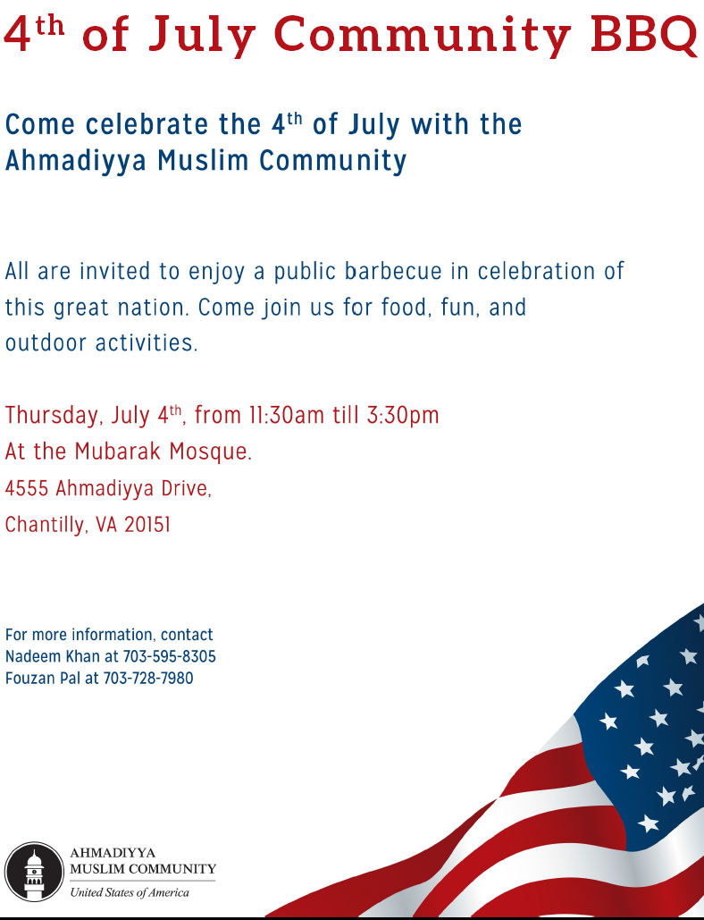
July 4th Flier

Slide 5
Sponsors
Costco - Silver
Giant Foods - Silver
ACE Hardware - Silver (Supplies)
Home Depot - Children workshop
Office Depot - Children goody bags & Water bottles

Slide 6
On the Day

Slide 7
Let’s have BBQ

Slide 8
Meet the guests

Slide 9
Greet the guests

Slide 10
Let’s Celebrate

Slide 11
Sponsors

Slide 12
Home Depot

Slide 13
Office Depot

Slide 14
Kids Time

Slide 15
Nasirat Time

Slide 16
Flag Hoisting

Slide 17
Flag Hoisting

Slide 18
Fire Marshall & Truck

Slide 19
Police Curiser

Slide 20
Kids Fun Time

Slide 21
Guest Speakers

Slide 22
Guest Speakers

Slide 23
Guest Speakers

Slide 24
Concluding Address

Slide 25
Concluding Dua

Slide 26
Group Photo with VIPs

Slide 27
PRESS COVERAGE
Ahmadi Muslims July 4th BBQ
July 4, 2013
This year's July 4th celebrations allowed the Ahmadiyya Muslim Community to use their recently built new mosque, Masjid Mubarak (House of Blessings). It was the first time the community was able to use the building for this purpose which allowed for an assortment of activities to be held. The barbecue was open to the general public, among which a number of political delegates were in attendance, as well as residents from in and around the neighborhood. An endless supply of food and cold drinks catered to the attendees of that sweltering 4th of July Thursday, people got to enjoy delicious hamburgers and hotdogs, washing them down with ice cold soda drinks.
Tariq Amjed, President of the chapter where the mosque is situated, was overall pleased to have so many guests attend the 4th of July function. "This is our first function at this new mosque site, inshallah (God willing) we will be holding many more functions in years to come."

Slide 28
The event was topped off with the hoisting of the American flag and listening to the National Anthem, after which the delegates were invited to say a few words. Rep. Mark Obenshain highlighted that it was our responsibility to make sure "the American dream is a dream that survives and thrives" for the benefit of our children, and our children's children, so that we can live in a country where all men are created equal. Naseem Mahdi, one of the community's most prominent member summed up by saying that it was our religious responsibility to be loyal to our country, that it was part of faith, as was taught by Prophet Muhammad of Islam, may be upon him. He went on to condemn all the terrorist attacks and violence committed in the name of religion, and even mentioned the campaign, Muslims For Life which began two years ago on the tenth anniversary of 9/11 to commemorate the victims who died that fateful day, during which 25,000 units of blood were collected to save lives. Mr. Mahdi highlights that the Ahmadiyya Muslim Community is doing their part to counter the negative actions people take in the name of Islam. He ended in silent prayer.

Slide 29
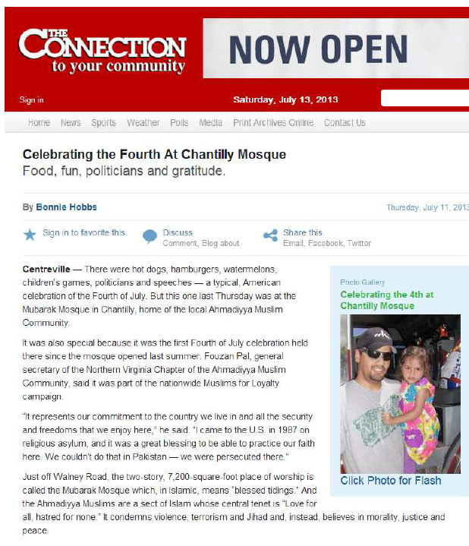
Press coverage

Slide 30
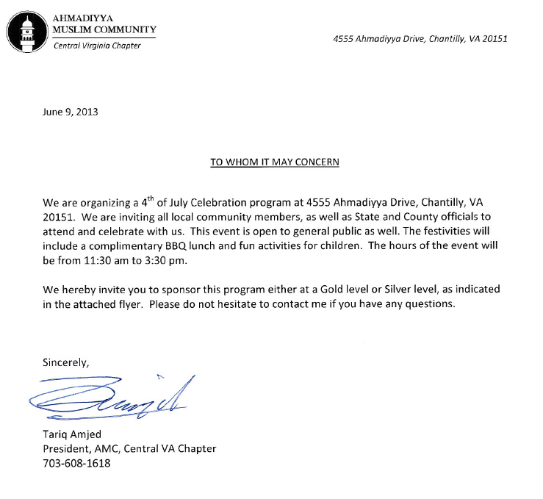
Sponsor Invitation Letter

Slide 31
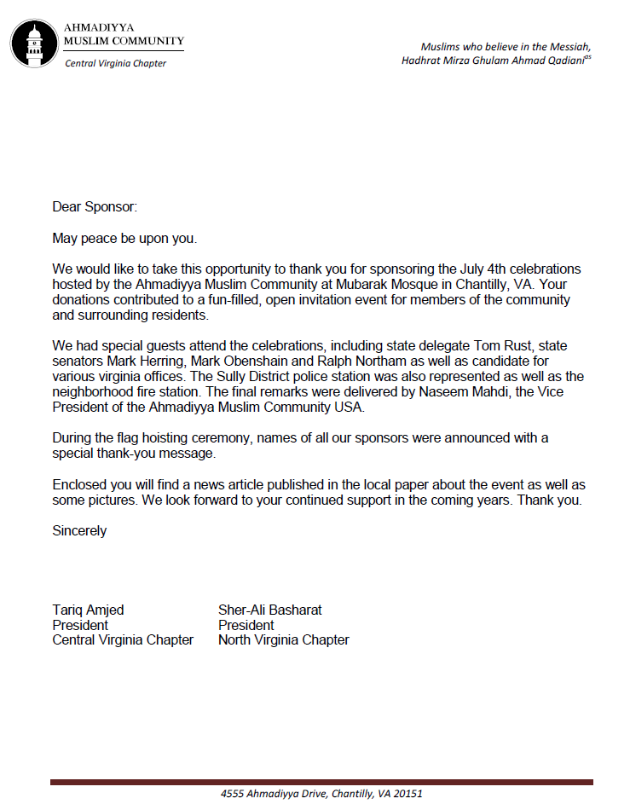
Letter of Thanks

Slide 32
Questions?

