Slide 1
Islam: Fact and Fiction
To insert your company logo on this slide
From the Insert Menu
Select “Picture”
Locate your logo file
Click OK
To resize the logo
Click anywhere inside the logo. The boxes that appear outside the logo are known as “resize handles.”
Use these to resize the object.
If you hold down the shift key before using the resize handles, you will maintain the proportions of the object you wish to resize.
Nasir M. Rana, Kashif Chaudhry
events.bos@ahmadiyya.us
978-600-8433

Slide 2
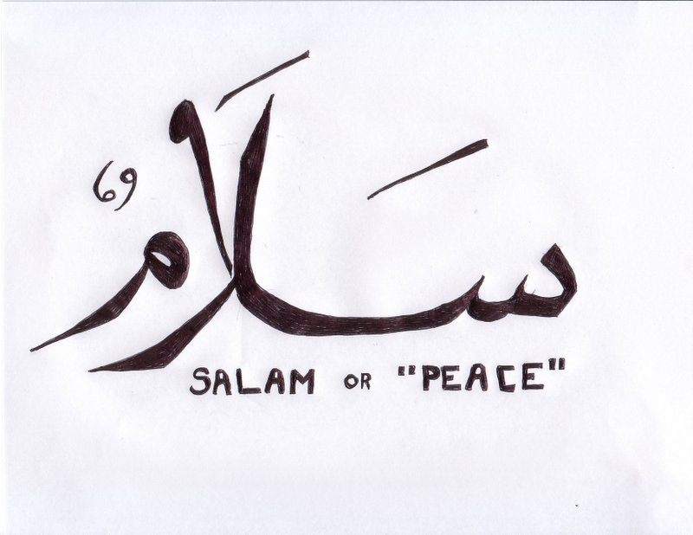
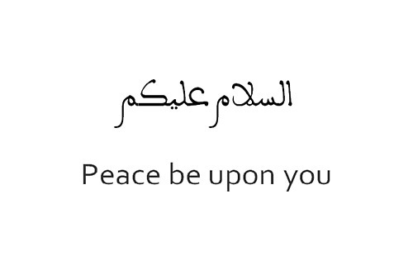
Islam’s Greeting of Peace
Assalamo Alaikum or Salam

Slide 3
Agenda
About Me
Ground Rules
Islam
Extremists / VENOM
True Islam and the Extremists
How can YOU help?

Slide 4
About Me

Slide 5
WHY are WE here?

Slide 6
Islam

Slide 7
The World’s Major Religions
Population (Billions)
3 Bn
Christianity
(2.2B, 32%)
Islam
(1.6B, 23%)
2 Bn
Hinduism
(1 B, 15%)
Buddhism
(500M, 7%)
1 Bn
Judaism
(14M, 0.2%)
1400 yrs
2000 yrs
2500 yrs
3500 yrs
4000 yrs
Age (years)

Slide 8
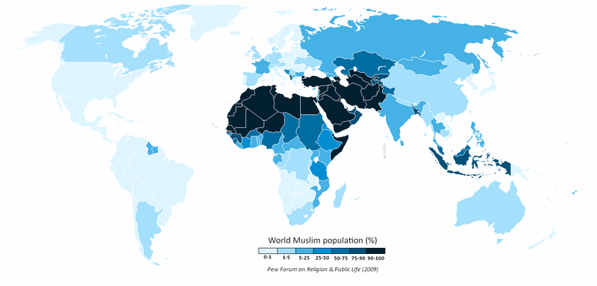
Muslims in the World

Slide 9
Most Populated Muslim countries with % of Muslims (2009)
Millions (%)
Interesting Facts
Indonesia 202 (88.2%)
Pakistan 174 (96.3%)
India 160 (13.4%)
Bangladesh 145 (89.6%)
Egypt 78 (94.6%)
Nigeria 78 (50.4%)
Iran 73 (99.4%)
Turkey 73 (98.0%)
Saudi Arabia 25 (97.0%)
China 22 (1.6%)
Russia 17 (11.7%)
USA 6 (2%)

Slide 10
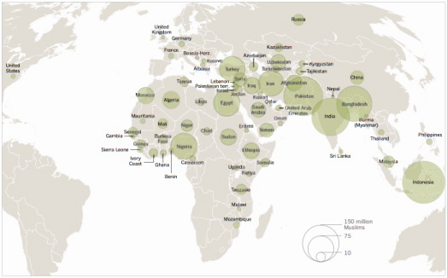
Distribution of Muslim Population
Source: Pew Forum on Religion and Public Life

Slide 11
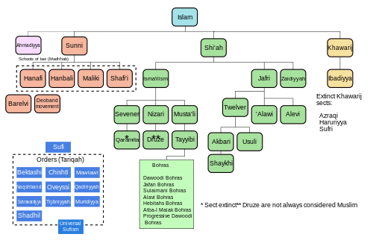
Islamic Schools and Branches

Slide 12
Islam, Muslim, VENOM
Meaning of Islam:
  Peace, Submission to God’s will.
Muslim:
  One who submits to God’s will – practices Islam
VENOM:
  Violent Extremism in the Name of Muslims

Slide 13
Origins
Adam, Noah, Moses ...
Jacob
Moses
Jesus
“12 Tribes”, Gen 35:23-26
“12 Princes”, Gen 25:13-16

Slide 14

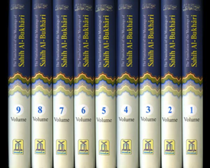
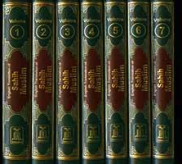
Muhammad’s Guidance to Mankind
God’s religion of Islam
revealed to Muhammad in
THE HOLY QUR’AN
Muhammad’s followers capture over 10,000 sayings and actions of the Prophet, providing mankind with clear examples of how to practice Islam
SUNNAH & AHADITH

Slide 15
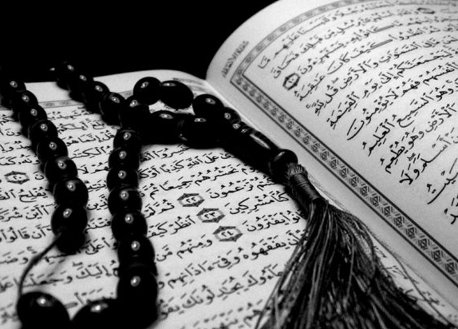
Quran
Revealed over 23 years
Recorded in real time
Jesus – 28 times
Moses – 136 times, more than any other person (Muhammad (pbuh) – 4 times)
Mary – exemplary believer
Validates other books and prophets
Prophecies - transportation, pharaoh’s body
Science – concordance or conflict?

Slide 16
Fundamental Beliefs
One God
Angels
All Prophets (more than 124,000)
All revealed books (five known)
  Scrolls (Abraham), Torah (Moses), Psalms (David) Gospel (Jesus), Qur’an (Muhammad)
Life after death (Heaven and Hell)

Slide 17
Fundamental Practices (Five Pillars)
Affirmation: “There is only one God and Muhammad is His messenger” (Kalima)
Prayer: Five daily prayers (Namaz or Sal’at)
Fasting: One month of daily fasting (Ro’za, Ramadhan)
Charity: A 2.5% levy on annual savings (wealth) to help poor and needy (Zak’aat)
Pilgrimage: Pilgrimage to Mecca once in a lifetime after fulfilling other obligations (Hajj)

Slide 18
Life as a Muslim – a communal faith
Birth – male circumcision
Adulthood – Premarital sex, intoxicants, gambling
Marriage – Free will, People of the book
Food rules – Pork, alcohol, dead animal, etc.
Forgiveness – God’s grace, faith plus actions

Slide 19
Extremists
VENOM – Violent Extremism in the Name of Muslims

Slide 20

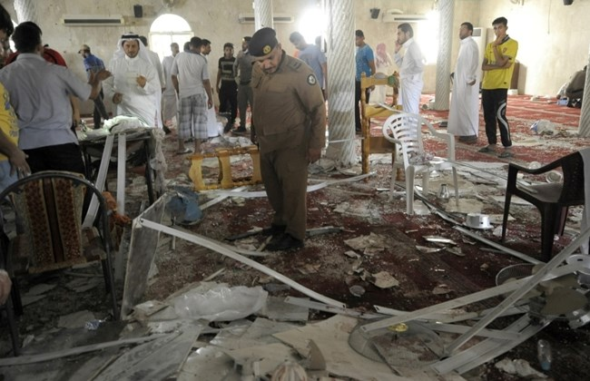
Terrorism in the name of Religion
In recent months and years, ISIS terrorists have attacked numerous innocent citizens in France, Lebanon, Belgium, Libya, Syria, Pakistan, Nigeria, Iraq, etc.
.

Slide 21
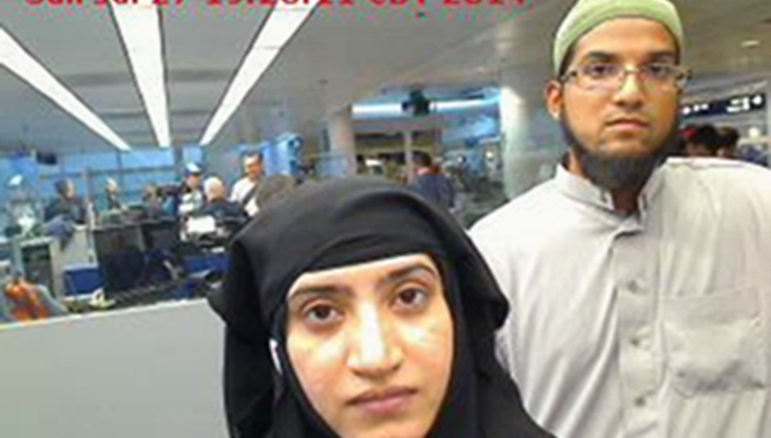
San Bernardino Shooters

Slide 22
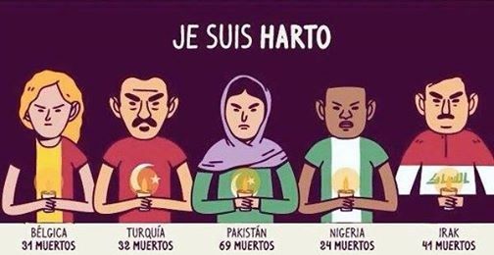
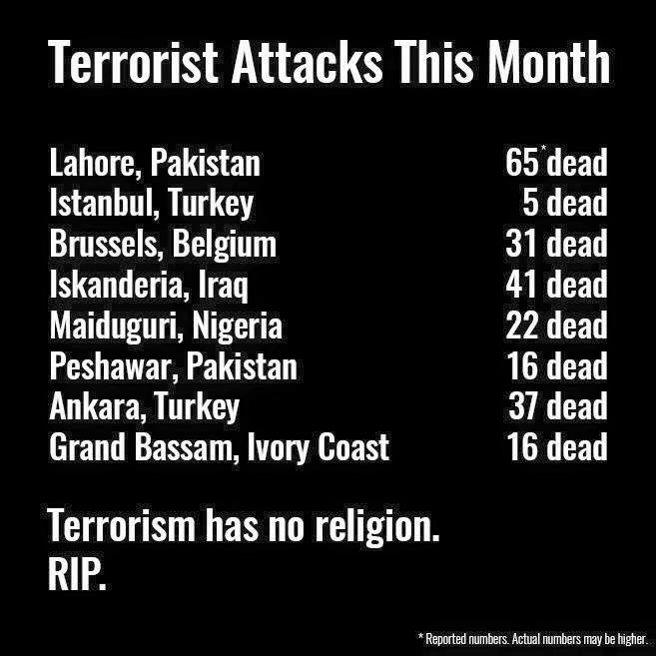
“I am Fed Up”

Slide 23
ISIS attacks Muslims
ISIS is determined to take out anyone who dares to disagree with it’s worldview.
Its members have slaughtered Yazidis and Christians, but the vast majority of its victims have been Muslims who refuse to acknowledge its authority.

Slide 24
All Terrorists Preferentially Target Muslims
The vast majority of the victims of the Taliban & Boko Haram are also Muslims.
Hundreds of Shia Muslims have been killed just in the last few years.
And hundreds of Ahmadi Muslims in Pakistan, Indonesia, Bangladesh, Afghanistan and even in America.

Slide 25
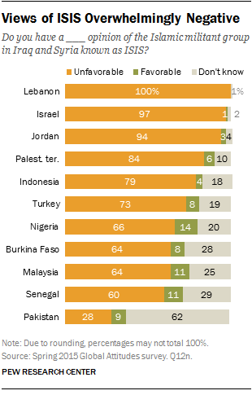
Muslims HATE ISIS!
It is therefore dishonest when some anti-Islam critics keep doggedly associating the faith of us Muslims with the acts of our tormentors.

Slide 26
Hmm….
Are you saying these terrorists’ ideology is not to blame for their violence?
Are you being an apologist for ISLAM!!

Slide 27
Yes Ideology is to Blame!
Yes, part of the motivation for religious extremism is rooted in perverted interpretation of scripture by radical extremists.
However, it is dishonest to label the vast majority of Muslims who reject such interpretations as non-devout or "nominal.”

Slide 28
Two Conflicting Views on Spread of Islam

Slide 29
Islam’s Spread – View #1 (basis for violent extremism)
When every method of persuasion (over 13 years of preaching) had failed, the Prophet (sa) took to the sword… that sword removed evil and mischief, the impurities of the heart and the filth of the soul. The sword did something more. It removed their blindness—they could see the light of truth—and it also cured them of their arrogance; arrogance which prevents people from accepting the truth… stiff necks and proud heads bowed with humility
-- Maulana Abul Ala Maududi
Muhammad preached Islam with a sword in one hand and the Quran in the other
-- Prof. Wilfred Cantwell Smith

Slide 30
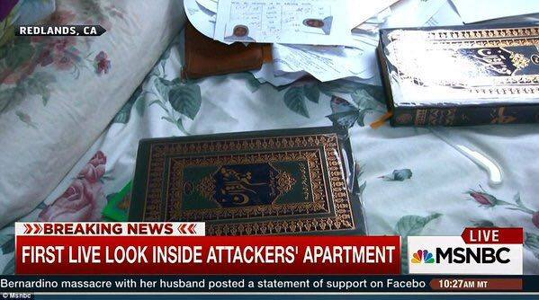
Maududi’s Interpretation
ISIS Leader Abu Bakr Al-Baghdadi also quoted Maududi

Slide 31
Radicalization Framework
Mission
  Greed
  Power
People
  Youth
  Economics
Material
  Arms
  Training
Financing
  Cash is King
Methodology
  Misinformation - Quran, History
  Abrogated verses
Marketing
  Enemy – external, internal

Slide 32
Extremism – Tool Box
Ideology (the carrot)
  Jihad (‘Holy War’)
  Heaven / 72 virgins
Export
  Loyalty (divide & rule)
Execution
  Suicide Killings
Retain recruits
  Apostasy
Suppress moderate Muslims, minorities, women (the stick)
  Takfir
  Blasphemy
Amplify Message – Press, Media

Slide 33
Islam’s Spread – View #2 (basis for Justice and Peace)
“…the prevalent tradition among the Muslims of attacking the people of other religions, which they call Jihad, is not the Jihad of Islamic Jurisprudence. It is against the clear instructions from God and His Messenger and is a grievous sin.”
– Mirza Ghulam Ahmad of Qadian, Promised Messiah (as), British Government and Jihad, May 1900
The critics are blind. They cannot see that the only sword Muhammad wielded was the sword of mercy, compassion, friendship and forgiveness—the sword that conquers enemies and purifies hearts. His sword was sharper than the sword of steel –
- Gyanandra Dev Sharma Shastri

Slide 34
True Islam and the Extremists
Jihad / ‘Holy War’
vs.
Holy Quran and the Holy Prophet (pbuh)

Slide 35
ISIS acts against Quran’s Message
An honest study of the Quran shows that groups like ISIS act in complete defiance of the injunctions of Islam.
The Quran, for instance, equates one murder to the elimination of the whole human race (5:32), and considers persecution and disorder on earth as an even worse offense (2:217).
It lays emphasis on peace, justice and human rights. It champions freedom of conscience and forbids worldly punishment for apostasy and blasphemy.

Slide 36
What!!
But ISIS claim to follow the Quran!! How can you excuse the Quran for the acts of ISIS?

Slide 37
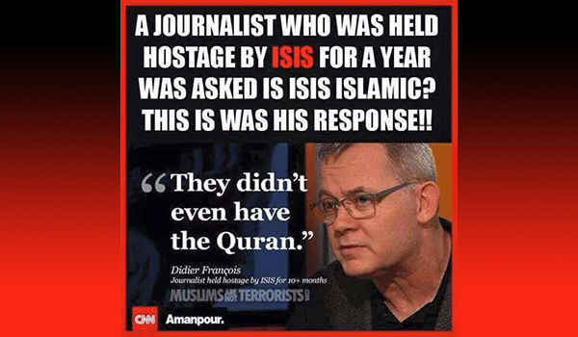
ISIS “didn’t even have the Quran”

Slide 38
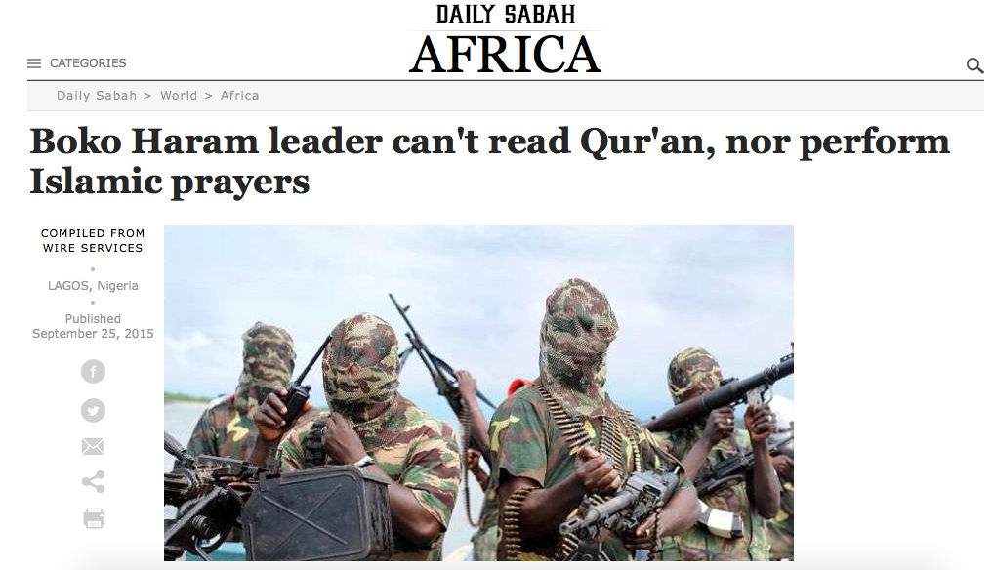
Boko Haram Leader Can’t Read Quran

Slide 39
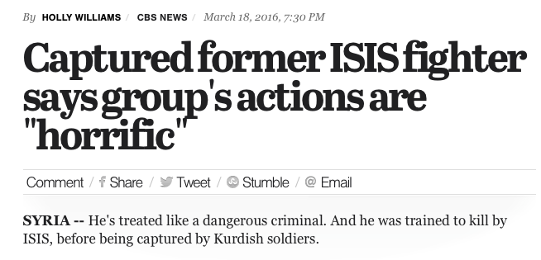
19 Year old Syrian recruit

Slide 40
Was this expected?
Ok, if ISIS is against Islam. Did Prophet Muhammad (pbuh) say anything about the rise of these monsters amongst Muslims?

Slide 41
Prophet Muhammad (pbuh)’s Prophecies
A study of the traditions of the Prophet Muhammad (pbuh) shows that he clearly warned us of the rise of religious extremism in this age in astonishing detail.
1,400 years ago, he prophesized that a time would come when nothing would remain of Islam but its name, nothing of the Quran but its word.

Slide 42
The Rise of Religious Extremism
Narrated Ali, the Messenger of Allah (pbuh) said:
“There will come a time upon the people when nothing will remain of Islam except its name and nothing will remain of the Quran except its words. Their mosques will be splendidly furnished but destitute of guidance. Their divines will be the worst people under the Heaven; strife (fitna) will issue from them and avert to them.”
- (Mishkat al-Masabih 1/91 Hadith 276)

Slide 43
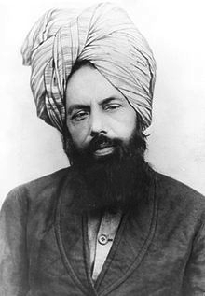
1900 - Ahmad rejects clerics’ definition of Jihad
Mirza Ghulam Ahmad of Qadian (pbuh) claims to be the awaited Messiah. Among his 80 books, Ahmad rejects the concept of violent Jihad with proof from Islam’s Quran and Hadith.
Some radical clerics declare Ahmadi Muslims as heretics for not supporting the call to wage violent Jihad.
Mirza Ghulam Ahmad^{as}
1835-1908

Slide 44
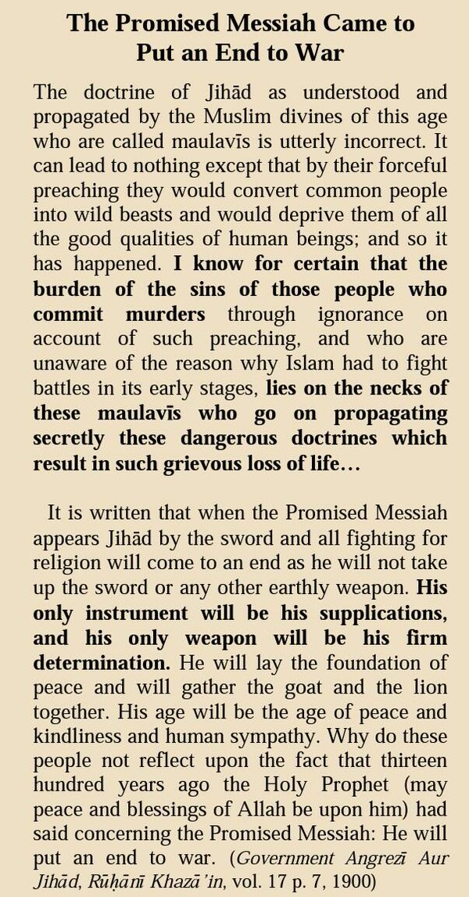
1900 - Ahmad rejects clerics’ definition of Jihad
Mirza Ghulam Ahmad of Qadian (pbuh) claims to be the awaited Messiah. Among his 80 books, Ahmad rejects the concept of violent Jihad with proof from Islam’s Quran and Hadith.
Some radical clerics declare Ahmadi Muslims as heretics for not supporting the call to wage violent Jihad.
Mirza Ghulam Ahmad^{as}
1835-1908
(“British Government and Jihad” - 1900)

Slide 45
What can WE do?

Slide 46
Recognize the real issue. Islam is not the problem
Extremists have hijacked Islam for non-religious purposes
Media’s coverage of VENOM is not balanced

Slide 47


Slide 48


Slide 49
Extremists Divide and Rule:
Misinformation, Fear, Division
Hate and Violence
Extremists’ Nightmare:
Education, Tolerance
Peace and Unity

Slide 50
How can YOU help?

Slide 51
Educate…
Let’s work together to educate America about True Islam
Educate Yourself
Your Family
Your Neighbors
Your Friends
Those Misinformed and Afraid
Engage, Don’t Isolate

Slide 52
Engage, Talk…
Engage, Don’t Isolate
- Attend Quran Exhibitions and help setup more
Visit a Mosque
- Attend a Muslim Convention (Jalsa USA)
Break Fast with a Muslim (Interfaith Iftar Dinner)
Attend Interfaith Dialogues and help setup more
Work with Muslims on Community Service projects
Talk!

Slide 53



We want to help America know Islam as taught
by its founder - Prophet Muhammad
pbuh
2009
2010
2011-present

Slide 54

We want to help America know Islam as taught
by its founder - Prophet Muhammad
pbuh
2009
2010
2011-present

Slide 55
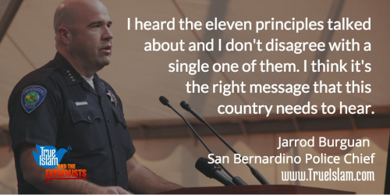
We want to help America know Islam as taught
by its founder - Prophet Muhammad
pbuh
2009
2010
2011-present

Slide 56
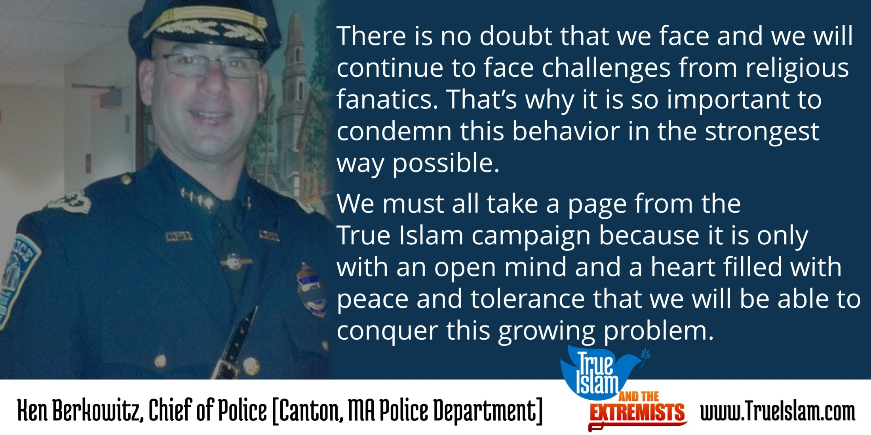
We want to help America know Islam as taught
by its founder - Prophet Muhammad
pbuh
2009
2010
2011-present

Slide 57
Islam: Fact or Fiction
To insert your company logo on this slide
From the Insert Menu
Select “Picture”
Locate your logo file
Click OK
To resize the logo
Click anywhere inside the logo. The boxes that appear outside the logo are known as “resize handles.”
Use these to resize the object.
If you hold down the shift key before using the resize handles, you will maintain the proportions of the object you wish to resize.
Nasir M. Rana
events.bos@ahmadiyya.us
978-600-8433

Slide 58
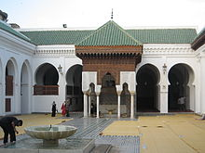
Al-Qarawiyin University
Fes, Morocco
Mosque-University founded by a Muslim woman, Fatima al-Fihri, in 859 with an associated school, or Madrasa
Oldest existing and continually operating educational institution in the world according to UNESCO and Guinness World Records^{[5]}; sometimes referred to as the oldest university
Fatima and her sister built Jāmi`at al-Qarawīīn, that granted degrees and sadaqah jariya, after they inherited their deceased father’s fortune
Gerbert of Auvergne studied there. Auvergne later went on to become Pope Sylvester II and has been given credit for introducing Arabic numerals and the concept of zero to the rest of Europe.^{[2]}

